Slide 1


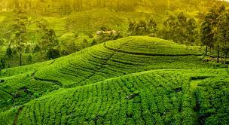

TeaBot
Tea Plantation Preservation Using an Intelligent Robot

Slide 2



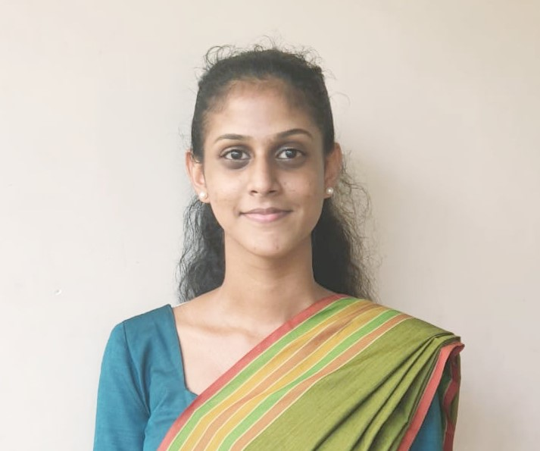

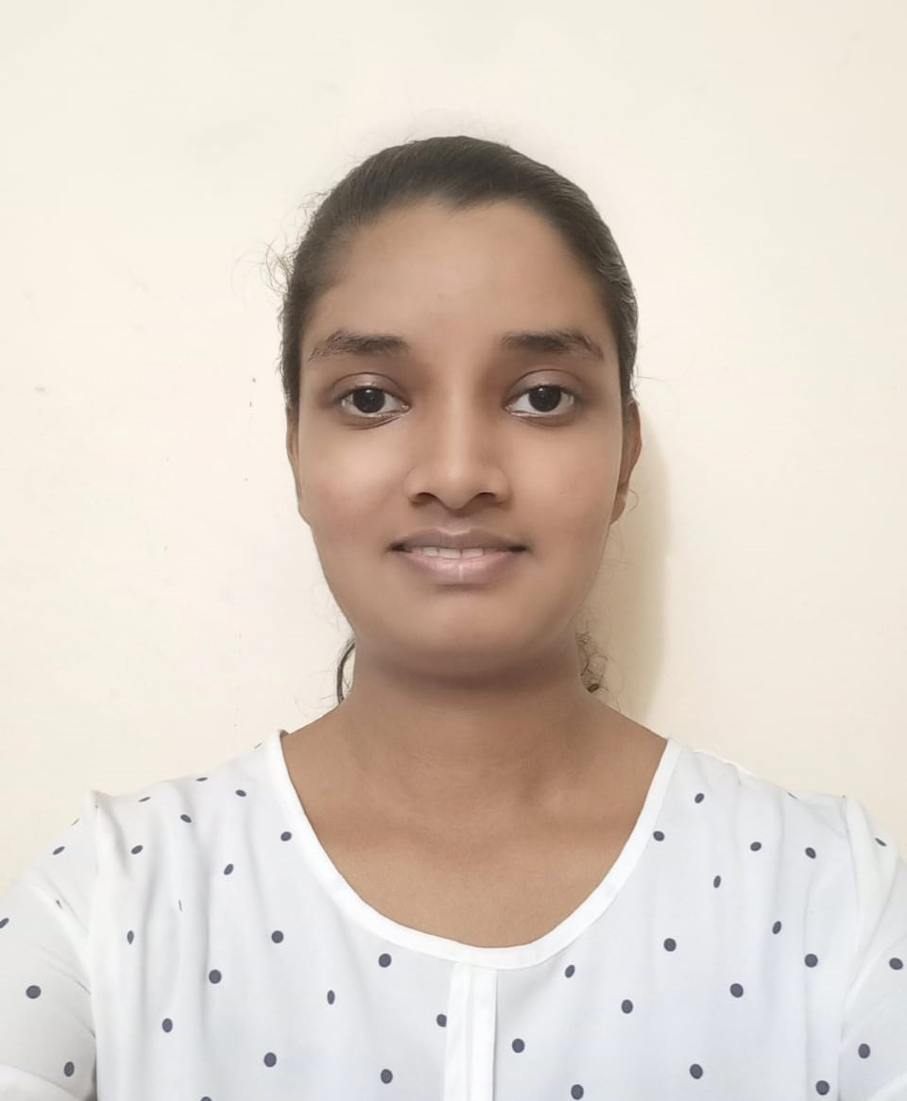
Team
Supervisor:
Ms. Shashika Lokuliyana
Co-Supervisor:
Ms. Narmada Gamage
External Supervisor:
Mr. Rajitha de Silva
IT19973470 Gunawardana I.I.E
IT20382476 Perera P.V.Y
IT20265410 Premathilake H.T.M
IT20011970 Bamunusinghe G.P

Slide 3
Introducing TeaBot…
TeaBot is a well developed autonomous robot to replace the human resource
Watering and fertilizing for tea estates. (Liquid fertilization)
Operate in off road conditions
No need a highly arranged clear paths to navigate.
Increasing the efficiency and decrease the water and fertilizer wastage.
TeaBot can identify the path to navigate and identify the end of the plant stems and liquid fertilizing the plants efficiently.

Slide 4

Research Problem
How to develop the TeaBot for the liquid fertilization process efficiently?

Slide 5
Objectives
Develop the robot controller of the TeaBot to navigate in off-road conditions with the computer vision guidance.
The development of the computer vision algorithm to navigate the robot automatically in the tea plantation rows in varying environmental conditions
Develop a computer vision algorithm to precisely identify the end of the tea stem and pass the coordinators to the liquid spraying controller.
Develop the liquid nozzles controller of the TeaBot to liquid fertilize the tea plants more efficiently.

Slide 6
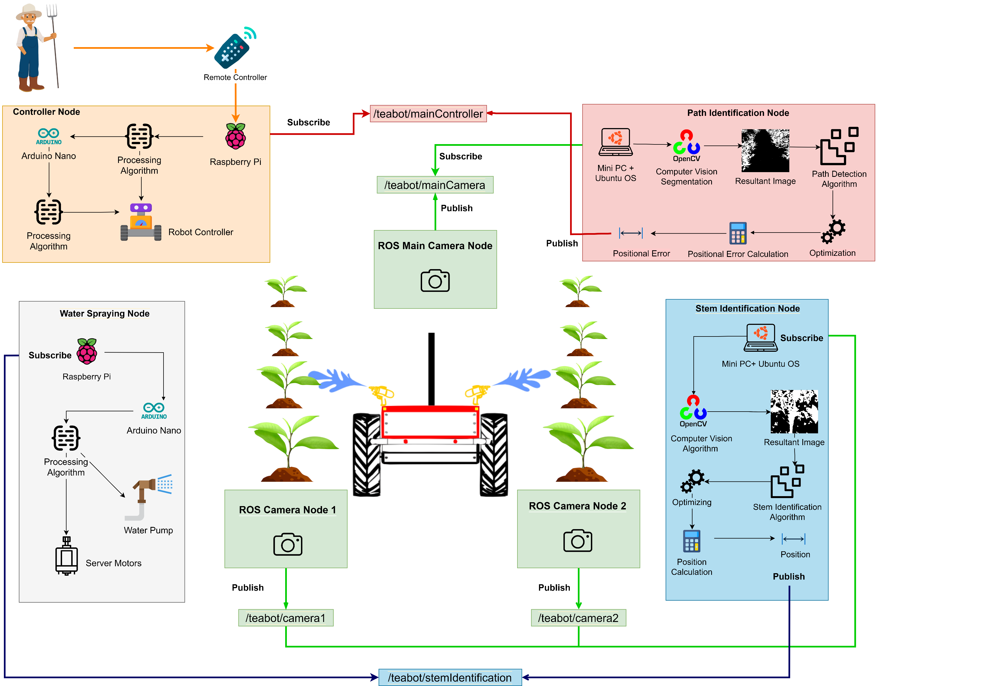
System Overview Diagram

Slide 7
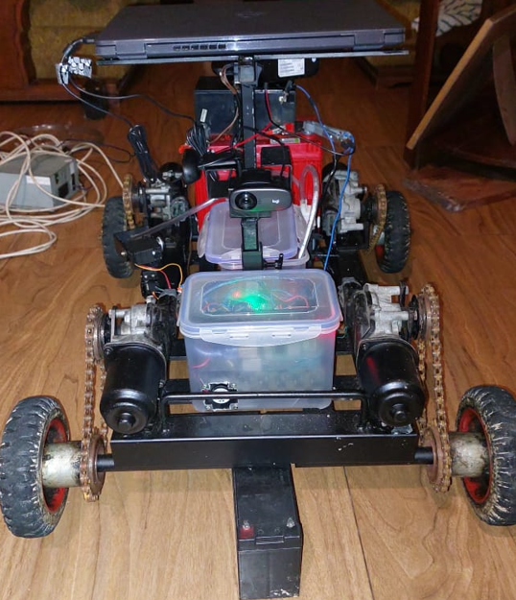
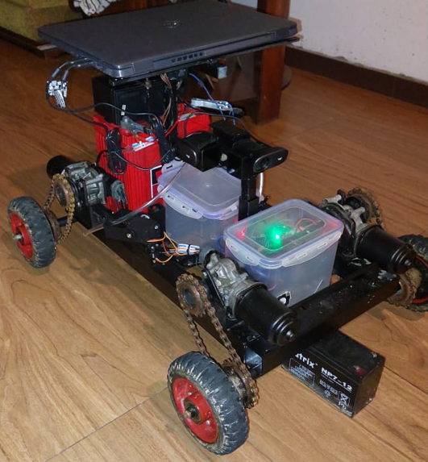
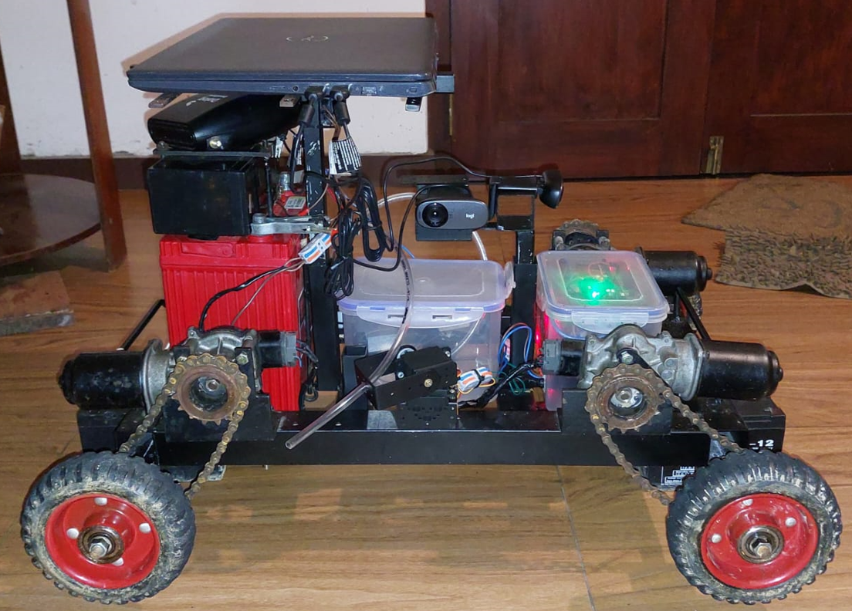

Slide 8
Robot Operating System
Why we use ROS? | Without ROS
Cooperate the components with low coupling and reduce the dependencies | have the possibilities to communicate the components
Can create the components separate. Each component is called as a node | Difficult to update the components since it has no proper convention to cooperate
nodes are communicating with ROS topics to send and receive data among the components | In programming, called it as low coupling high cohesion
Nodes are performing as publisher and subscriber | reduce the dependency level of the components
similar to the process of MQTT protocol

Slide 9
Twist Library
Why we use Twist? | Without Twist
Capable to provide the linear velocity and the angle to the ROS node | Have the possibilities to provide velocity and the angle by creating a custom python class
Pass the linear velocities for the x, y, z directions | But arising problems when connecting the nodes because of custom classes.
Pass the angles for the x, y, z directions | Not maintaining a convention to communicate among nodes
Robot controller’s data in and out are defined by the Twist library
Can create a separate node with Twist library to provide the linear and angles to the robot controller
No need to change any coding level of the robot controller
Twist is a convention
IT19973470 | Gunawardana I.I.E | 2023-044

Slide 10
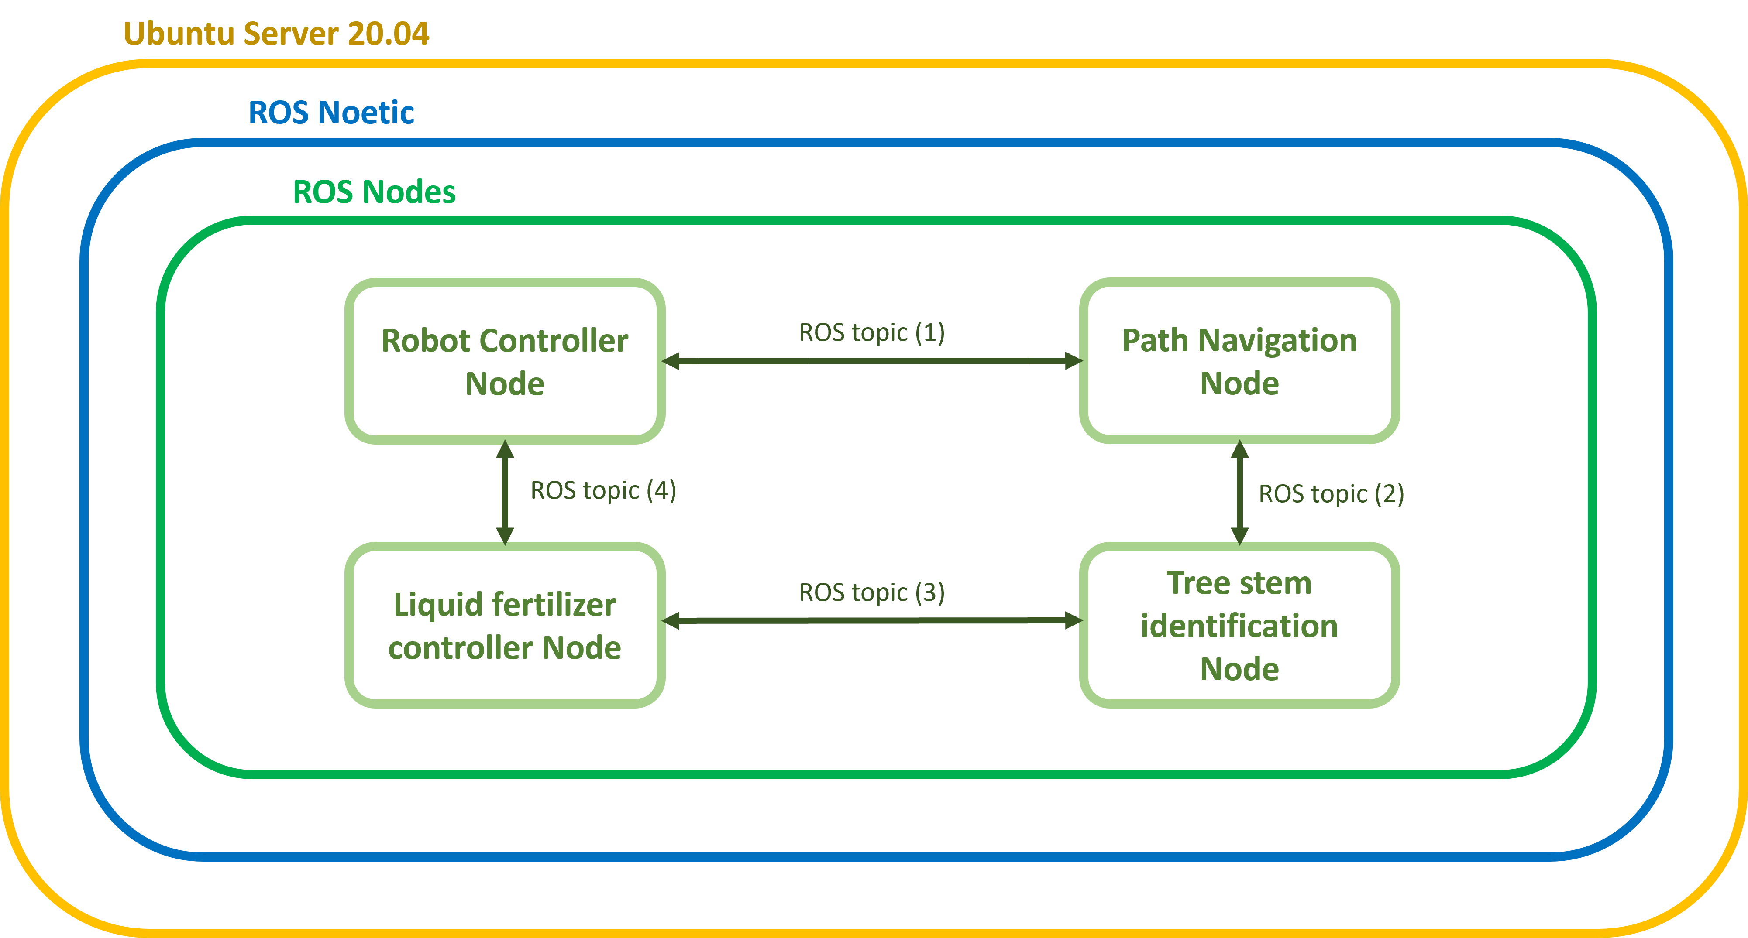
System Overview

Slide 11
System Components
Motor Controller
Arduino
Arm Controller
Arduino
Pump Controller
Arduino
USB
USB
USB
Raspberry Pi
ROS Wifi
Ubuntu PC
3 Cameras

Slide 12
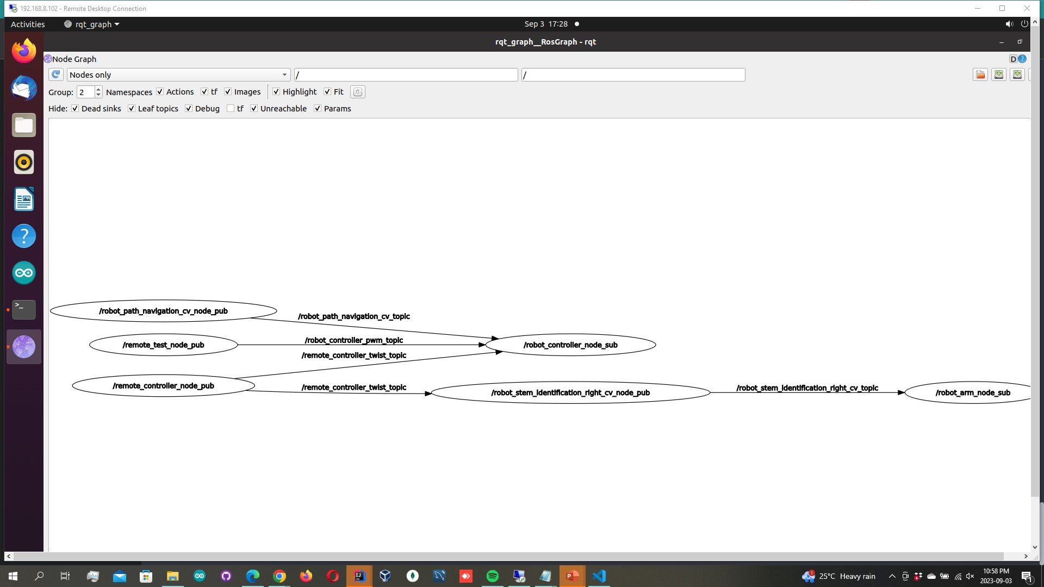
ROS Nodes Graphs

Slide 13
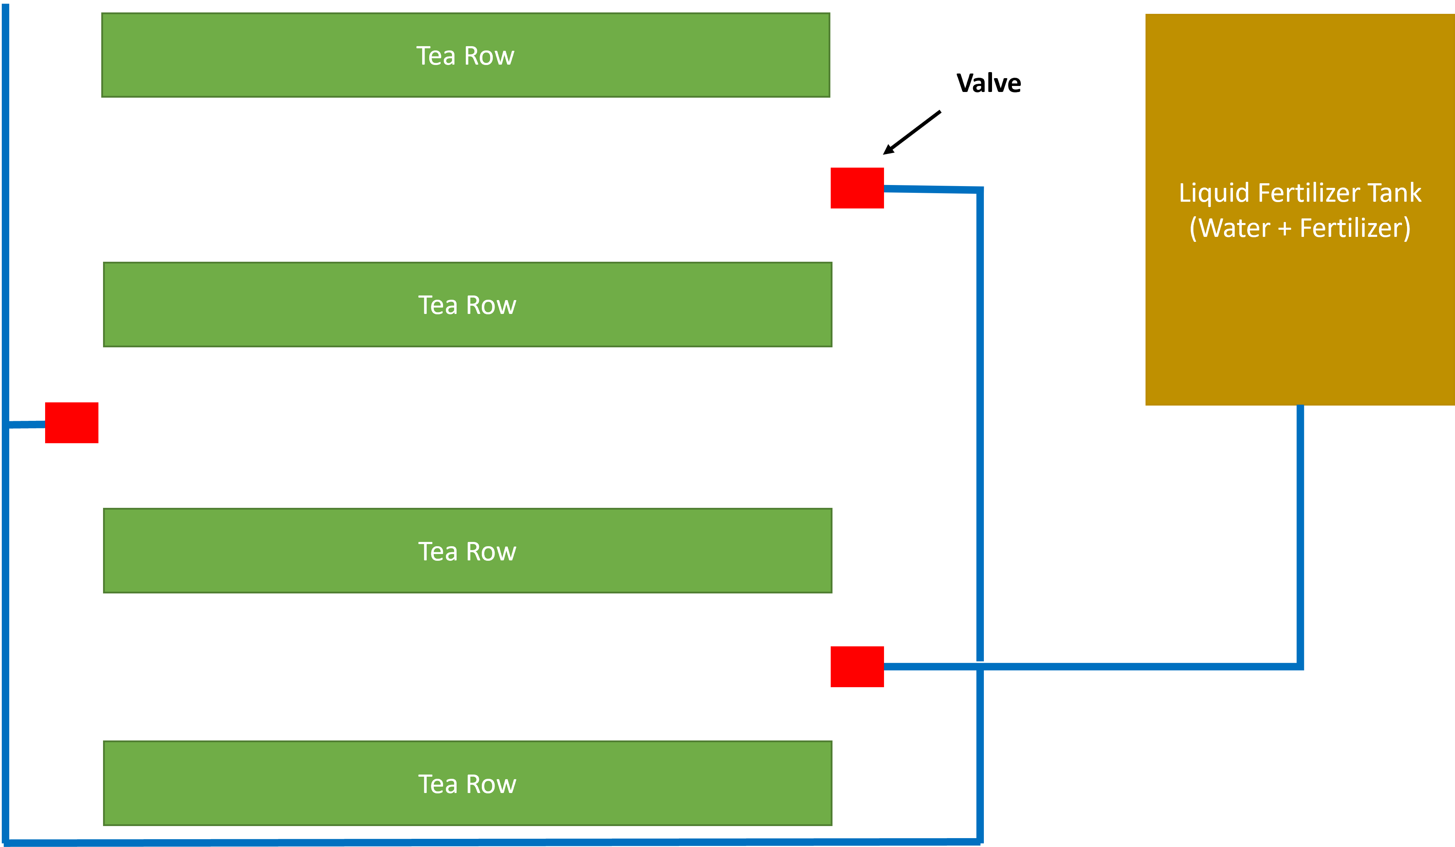
What is liquid fertilization?

Slide 14
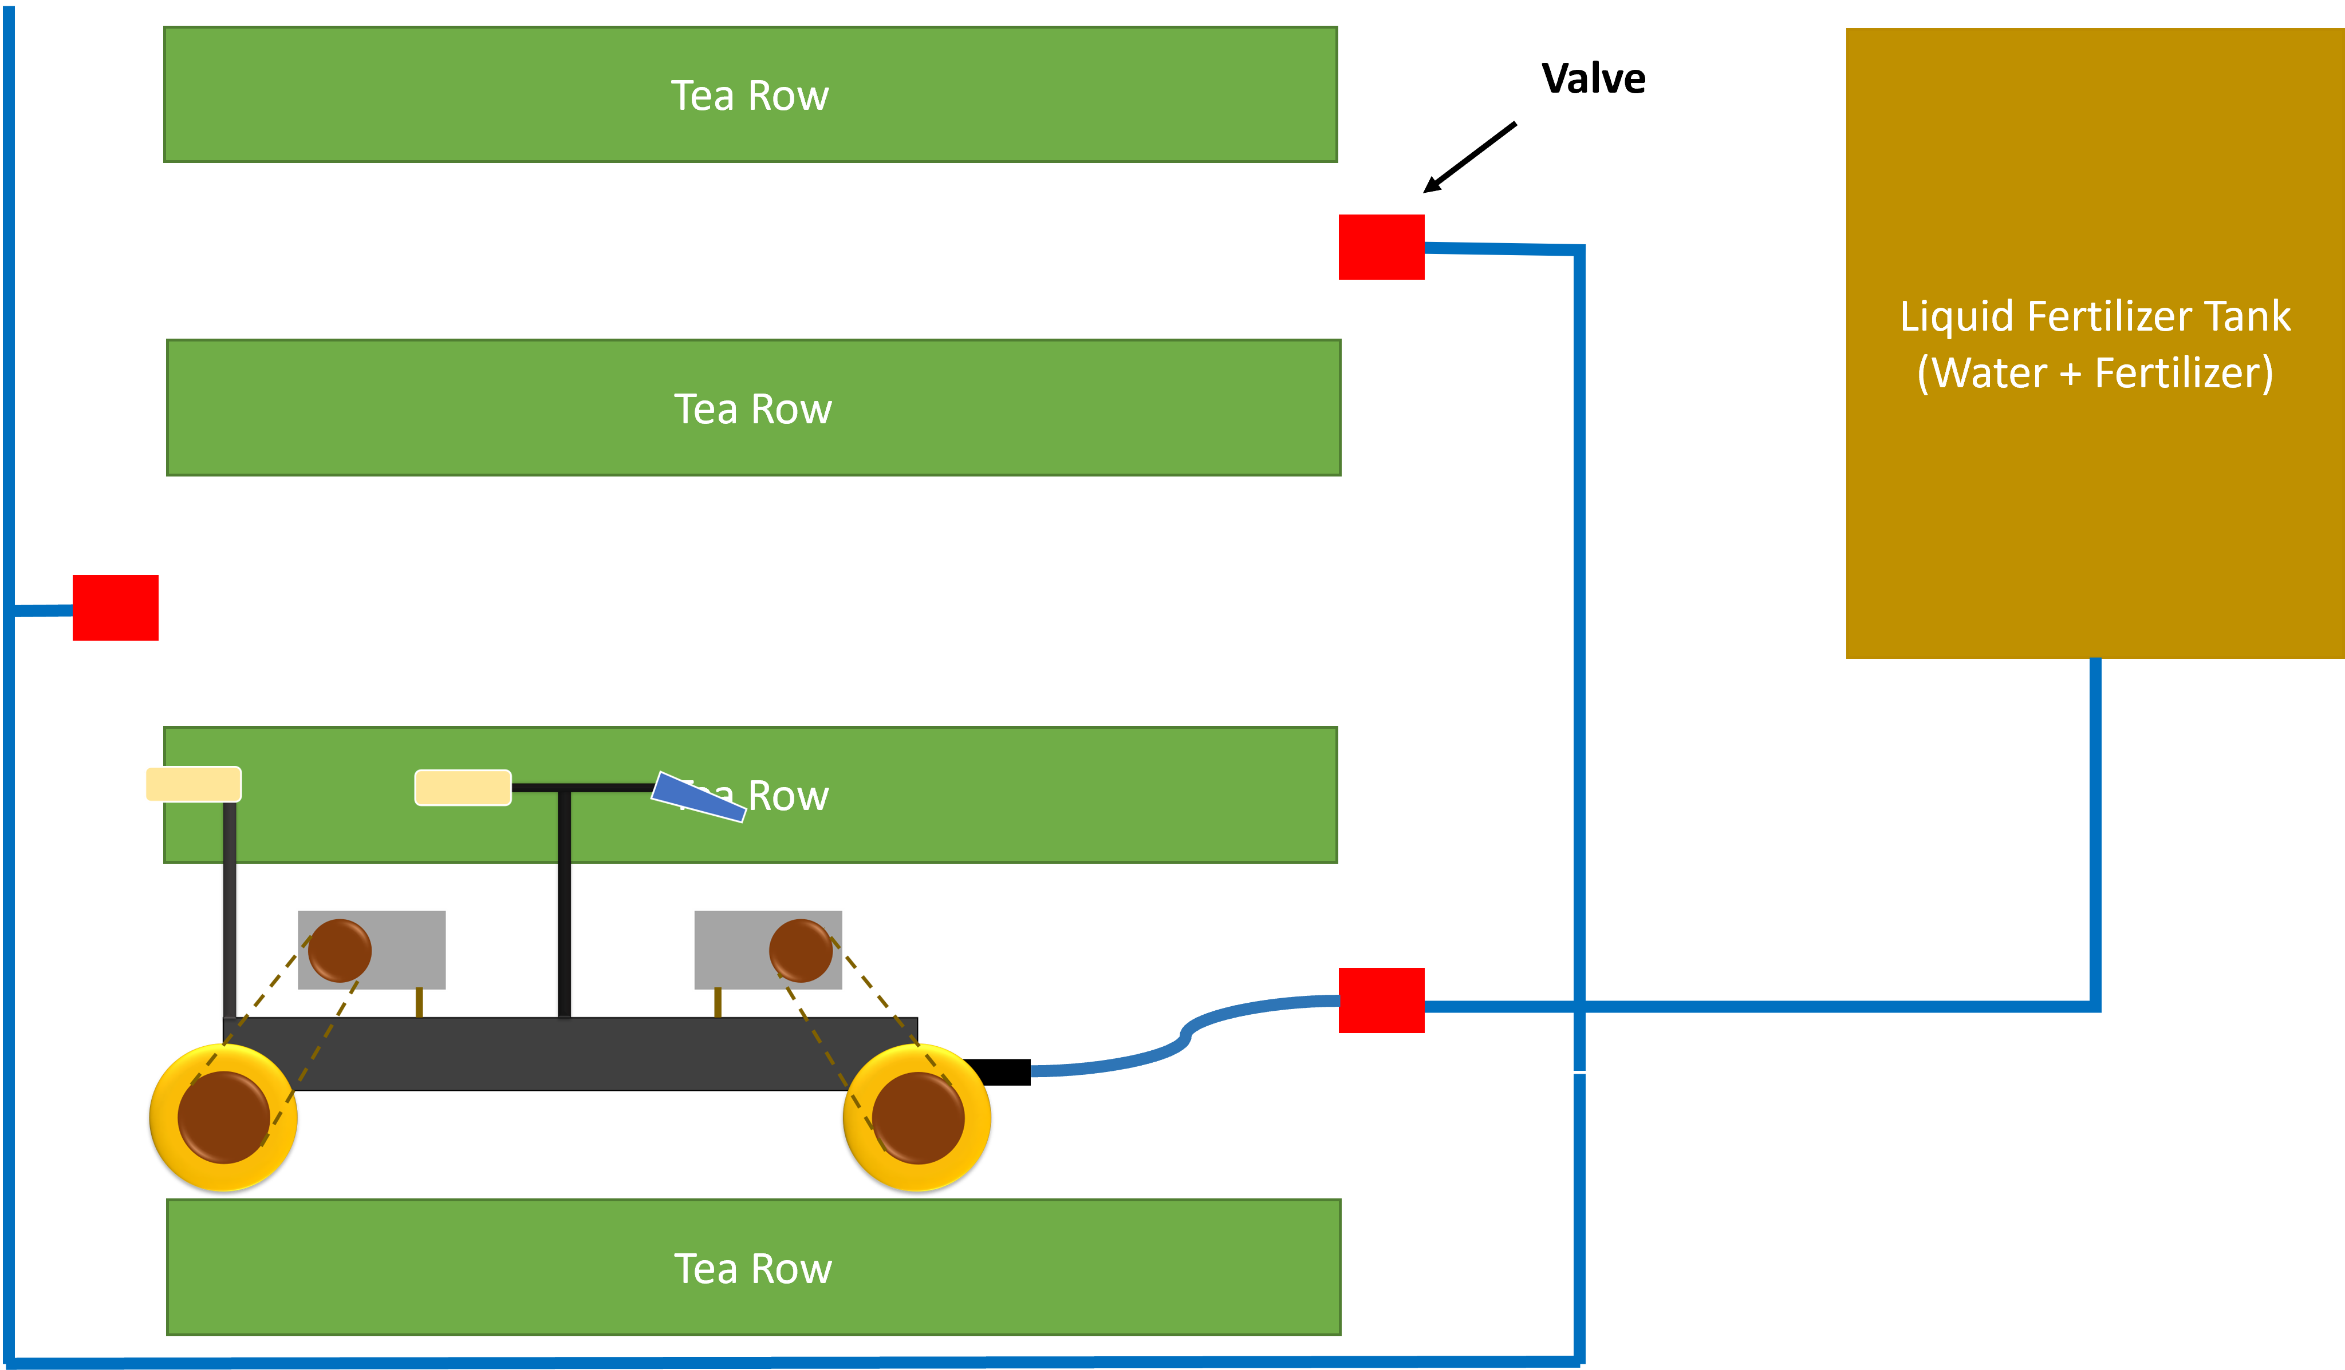

Slide 15
Budget
Item | Quantity | Amount (LKR)
Rubber wheels | 4 | 4,000
Sprocket, chain and wheel (gear system) | 4 | 10,800
Iron frame | 1 | 15,500
Motors | 4 | 14,000
43A Motor drivers | 4 | 5,400
Raspberry Pi | 1 | 90,000
12V 65Ah battery | 1 | 45,000
12V 8Ah battery | 1 | 5,000
Camera | 3 | 15,000
Liquid nozzles | 2 | 3,000
Servo motors | 8 | 9,600
Total |  | 220,000

Slide 16
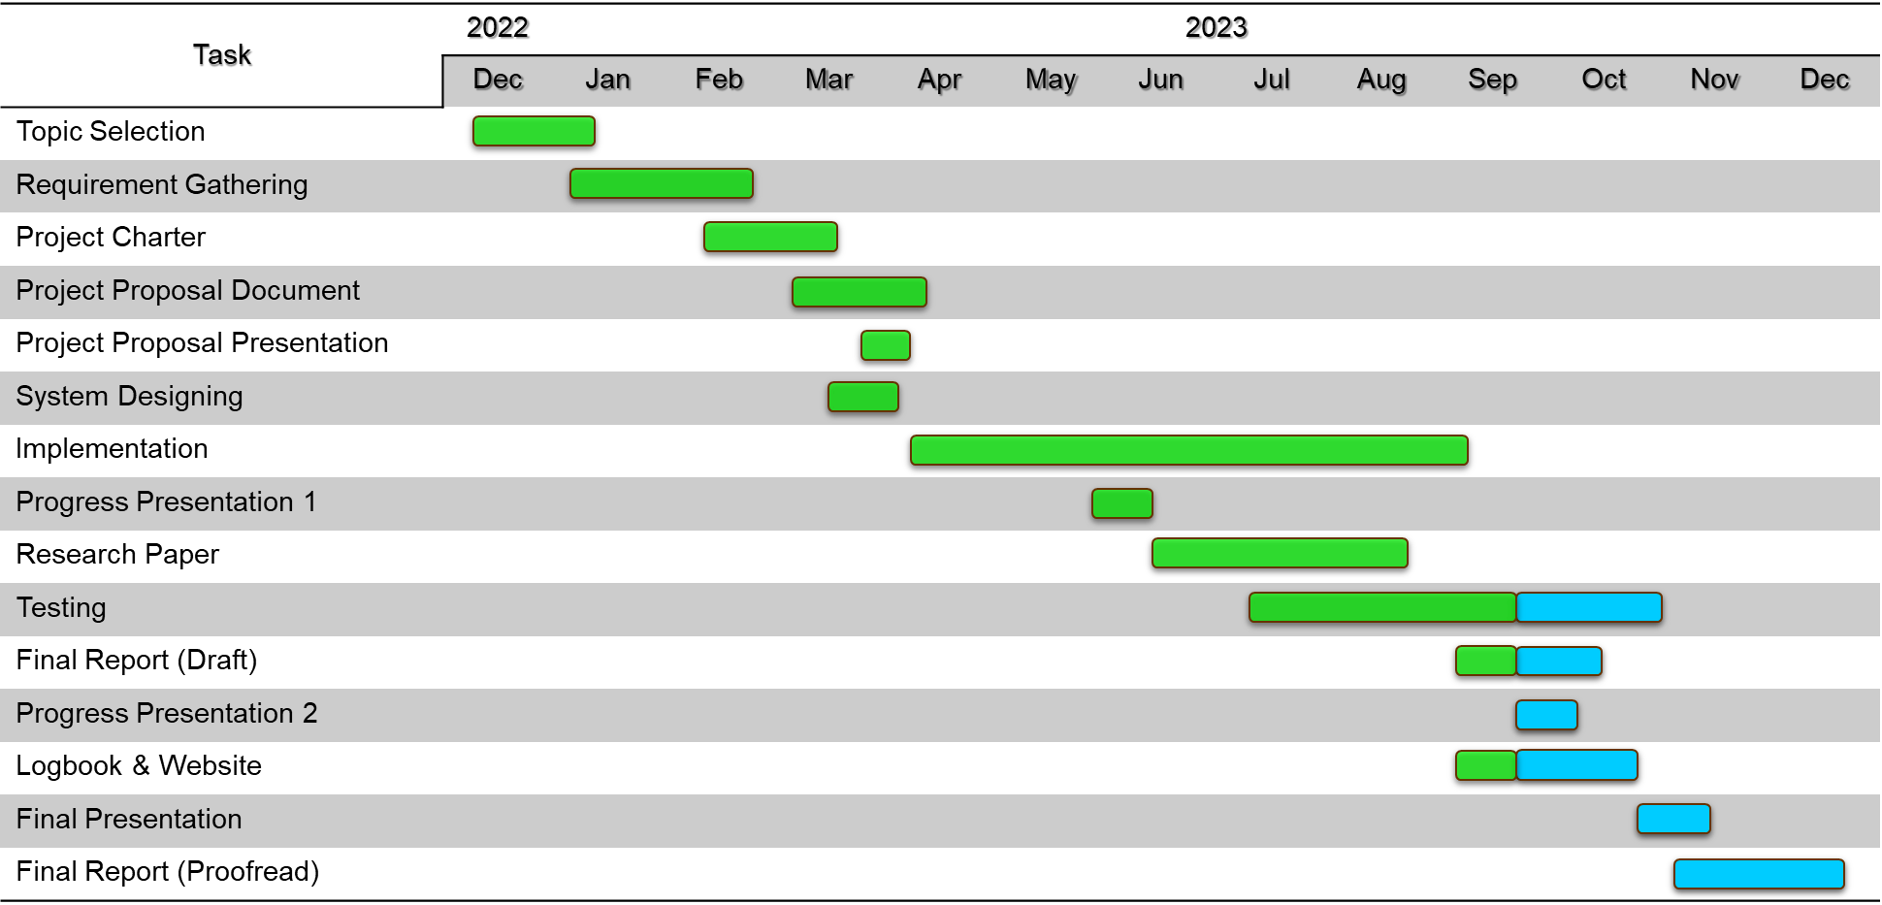
Gannt Chart
IT20011970 | Bamunusinghe G.P | 2023-044

Slide 17

IT19973470 Gunawardana I.I.E Software Engineering
IT19973470 | Gunawardana I.I.E | 2023-044

Slide 18
Background & Literature
How to drive the robot?
How to do the power management of the robot?
How to operate the robot with Raspberry Pi and Arduino?
How to operate the robot with ROS?
How will the path navigation drive the robot autonomous?
IT19973470 | Gunawardana I.I.E | 2023-044

Slide 19
Research Problem
How to navigate the TeaBot efficient in off-road conditions with the computer vision guidance and maintain the power more effective?
IT19973470 | Gunawardana I.I.E | 2023-044

Slide 20
Specific and Sub Objectives
Main Objective
Develop the robot controller of the TeaBot to navigate in off-road conditions with the computer vision guidance.
Sub-Objectives
Design the robot chassis to easily drive, easy to handle and consume low power and low cost to build.
Navigate the robot with the Twist library for the given linear velocity to go forward and backward and angles to steer.
Read the coordinates given by the computer vision to navigate the robot in the track and manual control if needed.
IT19973470 | Gunawardana I.I.E | 2023-044

Slide 21
Hardware - Robot Chassis
6 inches wheels – 4
Wiper motors (2 to 10 amps) – 4
Bicycle sprocket wheels (18 and 16) – 4
Bicycle chains – 4
Box bar + flat iron
BTS7960 motor drivers – 4
Arduino Nano – 1
Raspberry Pi 4 – 1
12V 35A battery
12V 8A battery
Cost – Rs. 178000
IT19973470 | Gunawardana I.I.E | 2023-044

Slide 22
Hardware - Robot Chassis
Move forward or backward
Set the speed to drive (Twist)
Steering according to the given angles
Turn left or right while driving forward or backward (Twist)
Skid steer to left or right
Smooth driving
Optimized to protect the motors from sudden start or stop
One dedicated battery for the motors for the maximum power
Another dedicated battery for the drivers + Arduino + raspberry for a better performance
Tested in a hard environment
IT19973470 | Gunawardana I.I.E | 2023-044

Slide 23
Hardware - Robot Chassis
Robot Chassis Size – 21 inches x 28 inches
0.3 m/s robot speed and carry 40kg
Uses 6 inches wheels and will change to 8 inches mud wheels
The motors are wiper motors since it is low speed, high torque and can carry large weight without getting stuck
The power distribution done by chain sprocket system to get the maximum torque
If the motors directly connect, need to add large wheels to increase ground clearance. The robot weight directly impact to the motor armature
Used 2 x 45A max motor drivers
Used Raspberry pi and Arduino nano with ROS Noetic for processing
IT19973470 | Gunawardana I.I.E | 2023-044

Slide 24
System Overview Diagram
IT19973470 | Gunawardana I.I.E | 2023-044

Slide 25
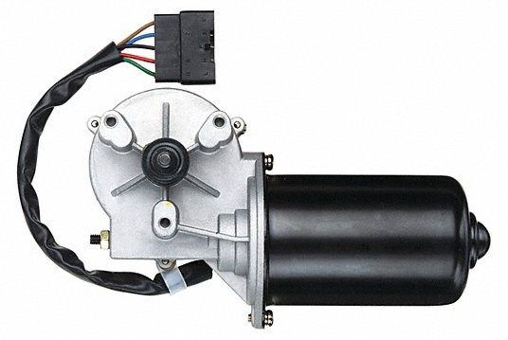
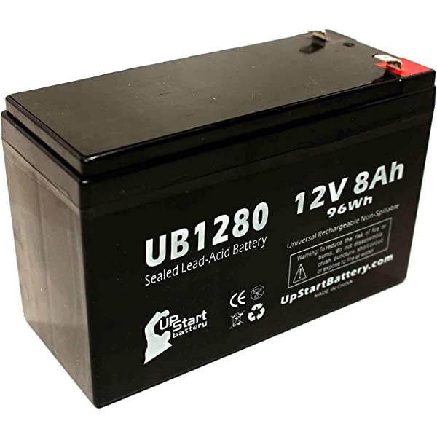

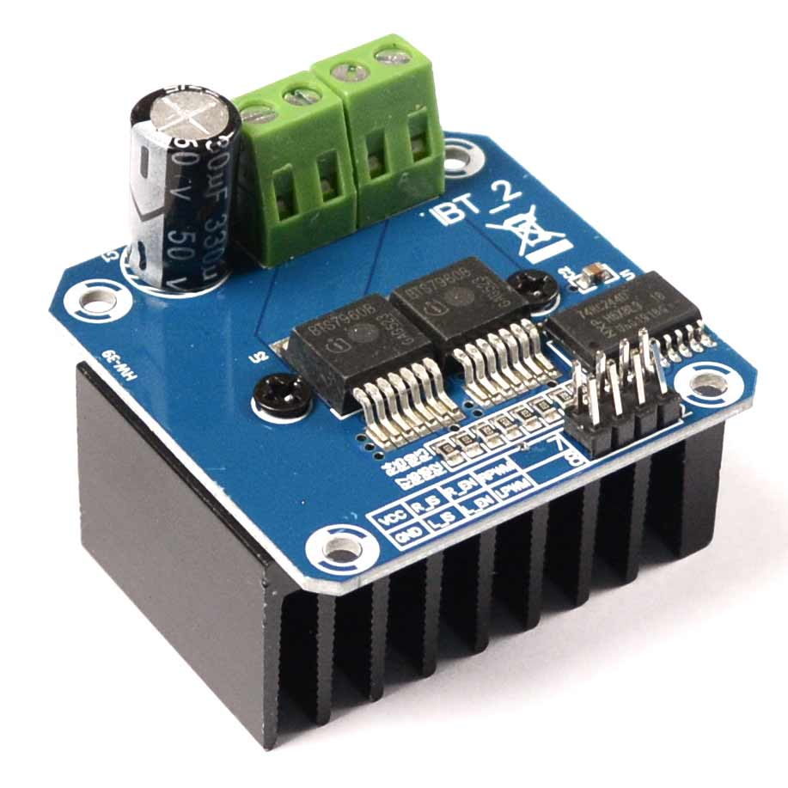
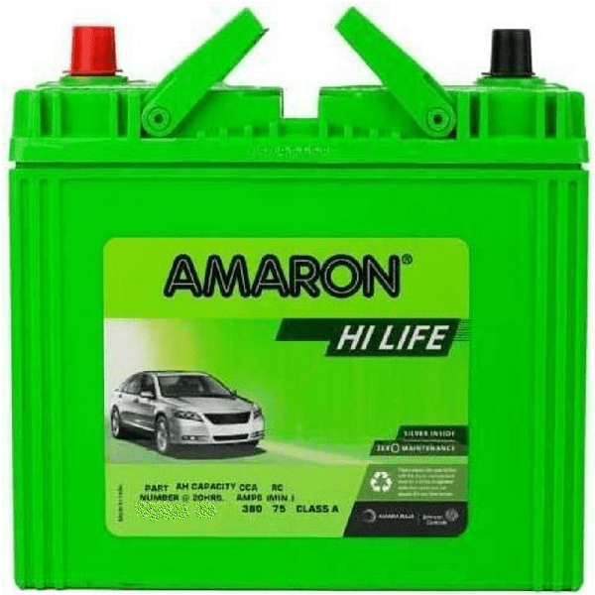
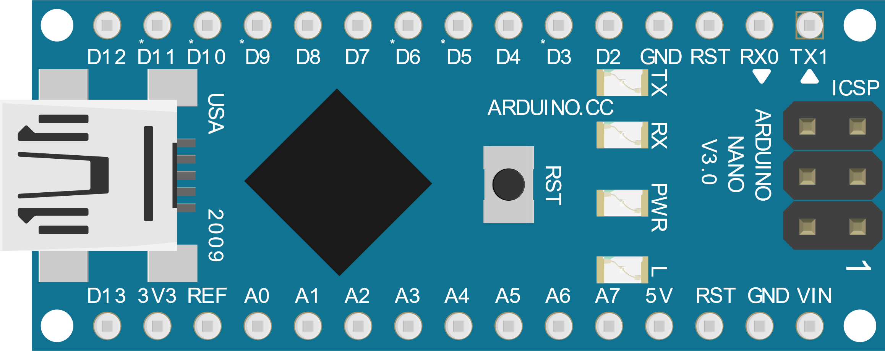
12V 8Ah
Motor Left Front
Power Line (8A)
Power Line (8A)
PWM Line
Motor Left Rear
Power Line (8A)
Data Line
BTS7960 Motor Driver (Left)
Power Line (35A)
Power Line (35A)
Serial
Robot Controller Node (Subscriber)
12V 35Ah
BTS7960 Motor Driver (Right)
Motor Right Front
Data Line
PWM Line
Motor Right Rear
Power Line (8A)
IT19973470 | Gunawardana I.I.E | 2023-044

Slide 26
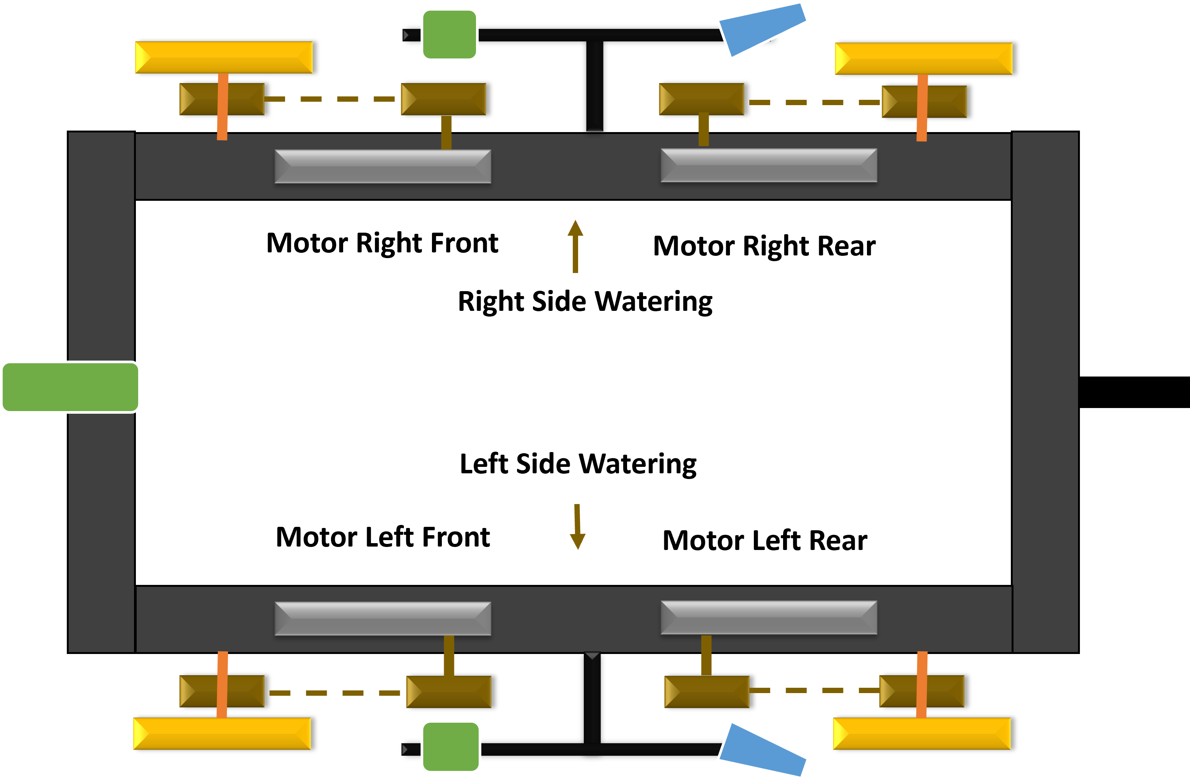
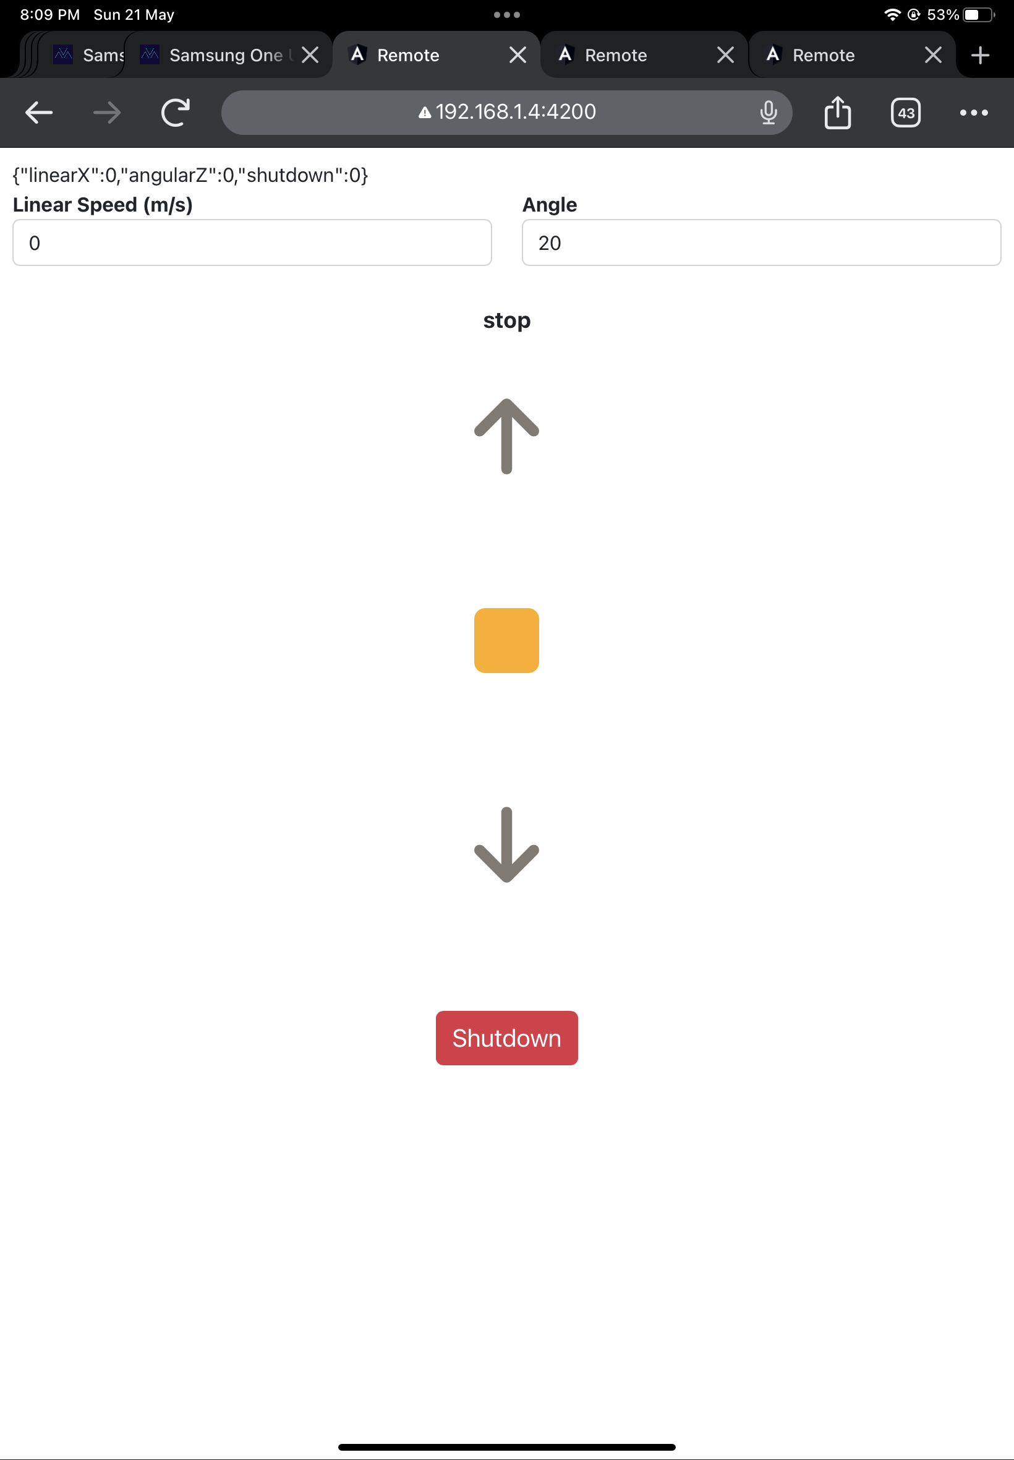

Tea Row
Twist Remote
+
θ
-θ
-
Tea Row
IT19973470 | Gunawardana I.I.E | 2023-044

Slide 27
Motor 1
Motor 3
Raspberry Pi
ROS Motor Controller Node
Motor 2
Motor 4
Algorithm
Serial Communication
Left Motor Driver
Right Motor Driver
Twist
Algorithm
Velocity
Max 0.3 m/s
Angles
Computer Vision Path Navigation
Arduino Nano
ROS Wifi
IT19973470 | Gunawardana I.I.E | 2023-044

Slide 28
Possible Solution
Motor 1
Motor 3
Raspberry Pi
ROS Motor Controller Node
Motor 2
Motor 4
I2C Communication
Twist
Left Motor Driver
Right Motor Driver
Velocity
Max 0.3 m/s
Angles
Computer Vision Path Navigation
ROS Wifi
Arduino Nano
Arduino Nano
IT19973470 | Gunawardana I.I.E | 2023-044

Slide 29
Possible Solution
Motor 1
Motor 3
Raspberry Pi
ROS Motor Controller Node
Motor 2
Motor 4
Serial Communication
Serial Communication
Twist
Left Motor Driver
Right Motor Driver
Velocity
Max 0.3 m/s
Angles
Computer Vision Path Navigation
ROS Wifi
Arduino Nano
Arduino Nano
IT19973470 | Gunawardana I.I.E | 2023-044

Slide 30
Developed Solution
Motor Controlling for time frames
Previous
0ms
300ms
600ms
900ms
1200ms
L
R
L
R
After
0ms
300ms
600ms
900ms
1200ms
L
R
L
R
L
R
L
R
IT19973470 | Gunawardana I.I.E | 2023-044

Slide 31
Developed Solution
Motor 1
Motor 3
Raspberry Pi
ROS Motor Controller Node
Motor 2
Motor 4
Algorithm
Serial Communication
Left Motor Driver
Right Motor Driver
Twist
Algorithm
Velocity
Max 0.3 m/s
Angles
Computer Vision Path Navigation
Arduino Nano
ROS Wifi
IT19973470 | Gunawardana I.I.E | 2023-044

Slide 32
Max velocity – 0.3 m/s
Angle -> 15 pixels – 150 pixels
(15 < angle < 150)
PWM = (velocity / max velocity) * 255
PWM angle = PWM – ((angle – 15) / 15)
If angle > 0 then right
If angle < 0 then left
If robotGo = 1 then Go forward
If robotGo = 2 then Go backward
If robotGo = 3 then Turn right
If robotGo = 4 then Turn left
[left, right, robotGo, pwmDelay, pwmDelayLevel, 1, 1]
IT19973470 | Gunawardana I.I.E | 2023-044

Slide 33
Serial Communication
Pass by Integer
Can pass by in integer data type
Pass values one after another
Difficult to synchronize
Takes much time to pass an array
Make more errors
No need any logic at receiver side to read values
Pass by String
Can pass by in String data type
Pass values once as a String by comma separated
Much easy to synchronize
Less errors
Takes very low time to pass an array
Need a logic at the receiver side to read values
Conclusion
Consider only the data transfer speed and less errors
Pass by String is the best
IT19973470 | Gunawardana I.I.E | 2023-044

Slide 34
Arduino Nano
Single Thread
In a Single thread without time delay,
Can control the two motors one after another quickly, since the loop is very fast. No delays occurred.
But this is not good for this setup, since the motors are carrying a heavy weight and this scenario will damage the motors.
In a single thread with a time delay,
Cannot control the two motors one after another quickly,
Since the loop is slow now because of the delays.
Designed a separate motor controlling algorithm to operate two motors parallelly.
Now motors are protected and can operate all motors simultaneously in a single-threaded environment.
Left
0
255
255
200
Right
0
255
100
120
0 – 150 delay (Start motors)
150 – 0 delay (Stop motors)
IT19973470 | Gunawardana I.I.E | 2023-044

Slide 35
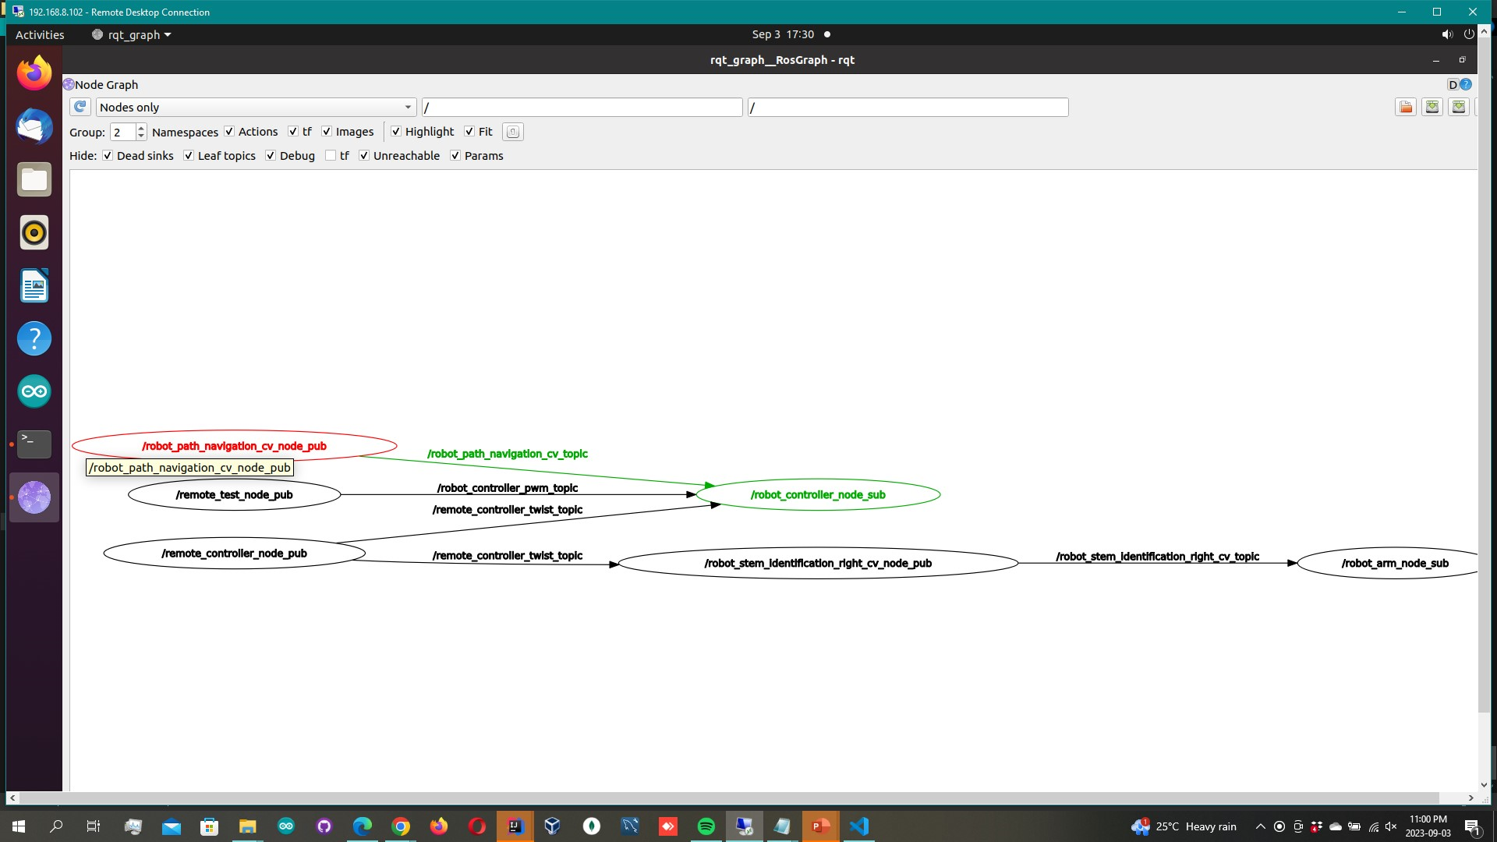
ROS Node
IT19973470 | Gunawardana I.I.E | 2023-044

Slide 36
METHODOLOGY
Work Breakdown Structure @PP1
Work Breakdown Structure @PP2
Technologies
Requirements
IT19973470 | Gunawardana I.I.E | 2023-044

Slide 37
Work Breakdown Structure @PP1
Robot Controller
Motor Controller
Autopilot
Remote Controller
Path End Detection
Drive
Make the robot structure
Provide computer vision coordinates
Angular app for remote development
Develop the algorithm
Drive the robot by providing PWM values
Make the power supply
Test the robot autopilot
Create the communication
Testing the performance in various scenarios
Drive the robot forward, backward, steer left and right
Create the motor driving
Finetune the algorithm based on performance
Drive it in off road conditions to test
Twist library to linear and angular movements
Completed
To Be Completed
Drive the robot with Twist library
IT19973470 | Gunawardana I.I.E | 2023-044

Slide 38
Work Breakdown Structure @PP2
Robot Controller
Motor Controller
Autopilot
Remote Controller
Path End Detection
Drive
Make the robot structure
Provide computer vision coordinates
Angular app for remote development
Develop the algorithm
Drive the robot by providing PWM values
Make the power supply
Test the robot autopilot
Create the communication
Testing the performance in various scenarios
Drive the robot forward, backward, steer left and right
Create the motor driving
Finetune the algorithm based on performance
Drive it in off road conditions to test
Twist library to linear and angular movements
Completed
To Be Completed
Drive the robot with Twist library
IT19973470 | Gunawardana I.I.E | 2023-044

Slide 39





Technologies
Technologies
Python
ROS Noetic
Algorithms
Twist to PWM
Motor Control
Angular
Ubuntu 20.04
MQTT
IT19973470 | Gunawardana I.I.E | 2023-044

Slide 40
Requirements
Functional Requirements
Non-Functional Requirements
Efficient
Easy to handle
Navigate the robot forward and backward
Driving the robot with the computer vision coordinates
Drive the robot in manual mode
Performance
IT19973470 | Gunawardana I.I.E | 2023-044

Slide 41
Results & Discussion
Previous
IT19973470 | Gunawardana I.I.E | 2023-044

Slide 42
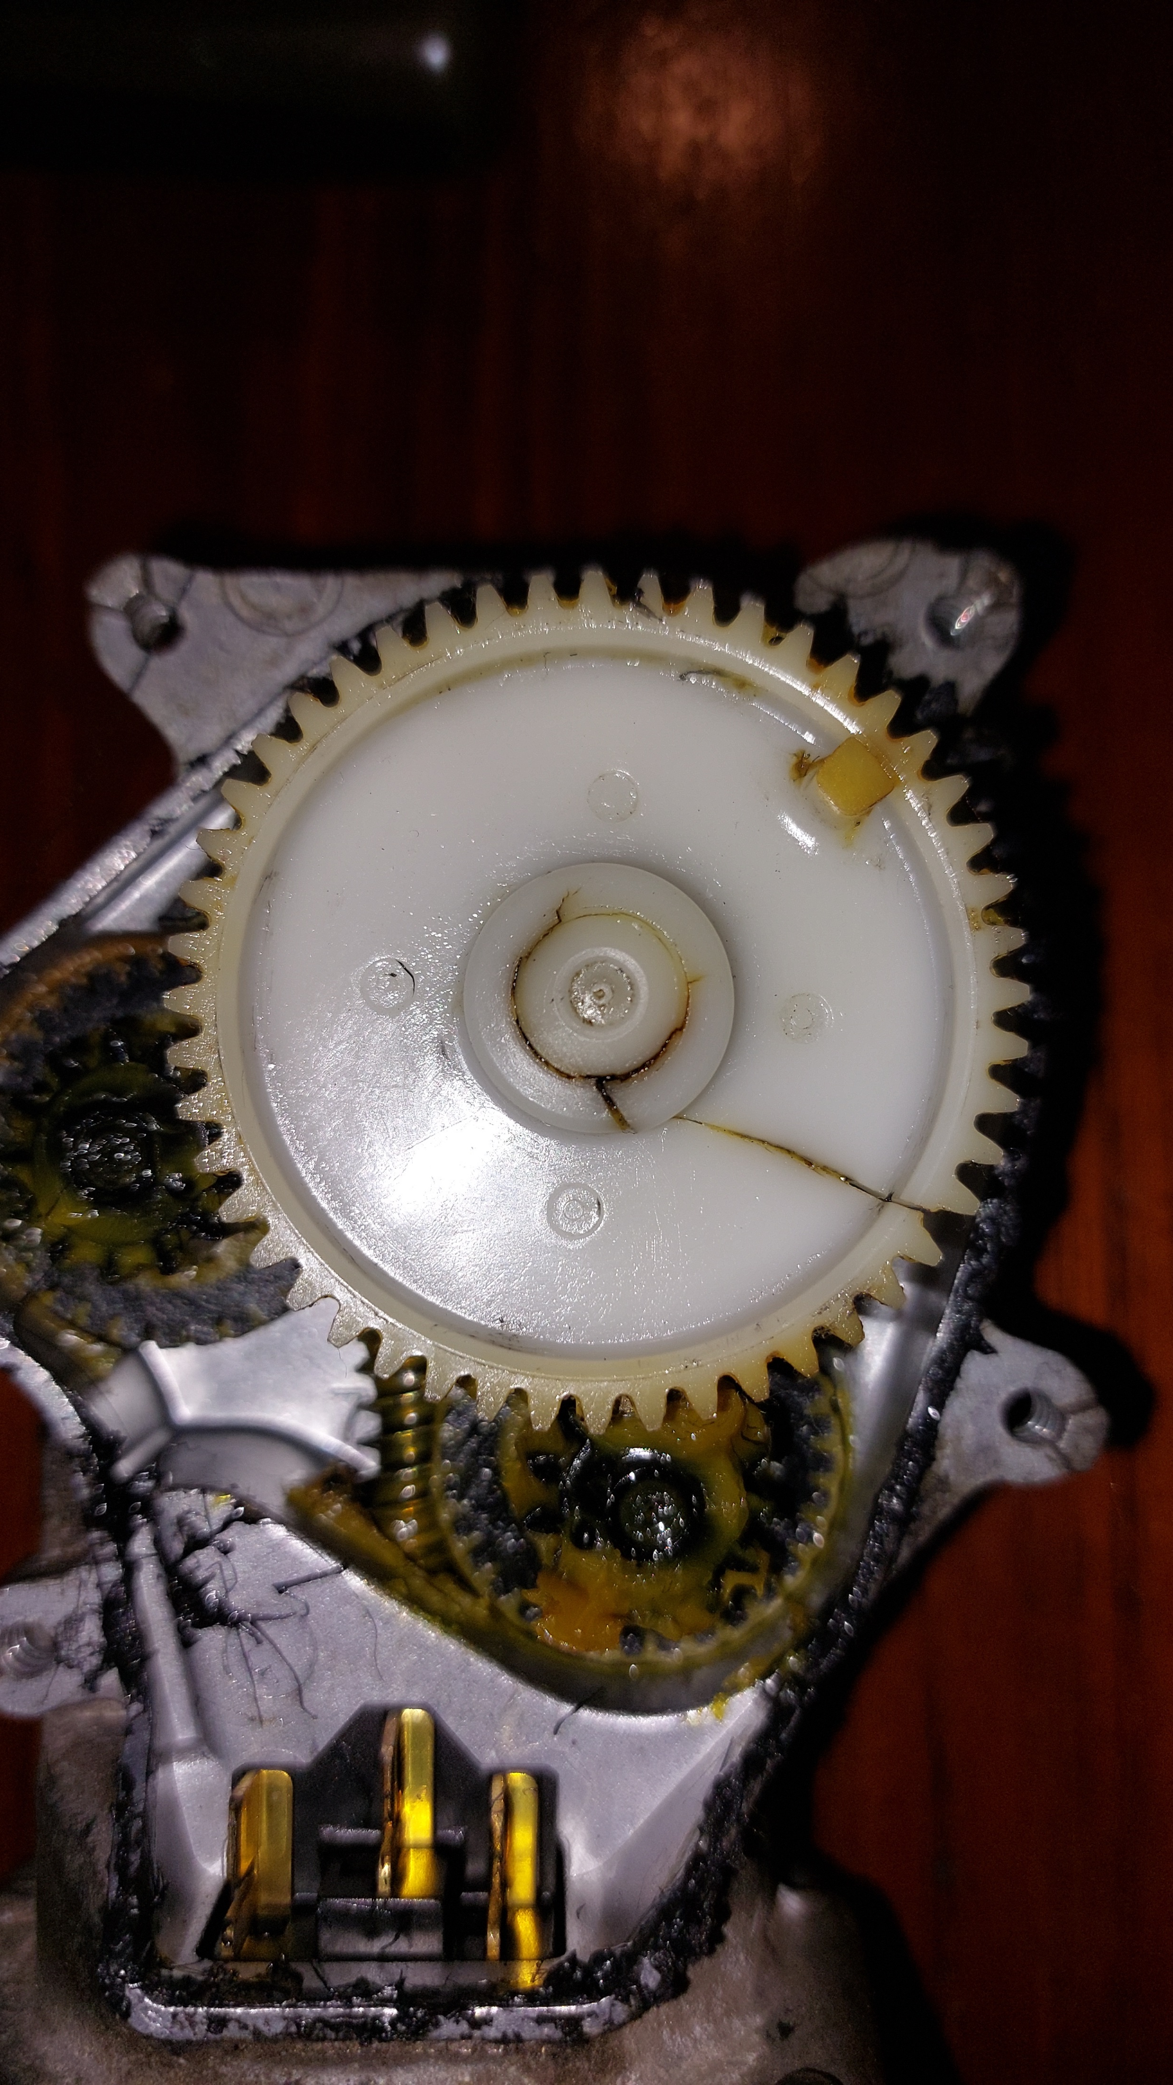
IT19973470 | Gunawardana I.I.E | 2023-044

Slide 43
Results & Discussion
After
IT19973470 | Gunawardana I.I.E | 2023-044

Slide 44
Conclusion
Motors are protected and can operate all motors simultaneously in a single-threaded environment.
Consider only the data transfer speed and less errors.
Pass by String is the best for serial communication.
IT19973470 | Gunawardana I.I.E | 2023-044

Slide 45
References
[1] L. Grimstad and P. J. From, “Thorvald II - a Modular and Re-configurable Agricultural Robot,” IFAC-PapersOnLine, vol. 50, no. 1, pp. 4588–4593, 2017, doi: 10.1016/j.ifacol.2017.08.1005.
[2] Cihan YURTSEVER, Y. ERTAS, O. SUSTAM, and C. ULU, “Development of an Agriculture Robot for Row-type Seed Sowing Applications,” J. Selcuk. Spec. Issue 2020 (ICAT’20, vol. 2020, pp. 228–242, 2020.
[3] E. P. Godoy, G. T. Tangerino, R. A. Tabile, R. Y. Inamasu, and A. J. V. Porto, “Networked control system for the guidance of a four-wheel steering agricultural robotic platform,” J. Control Sci. Eng., vol. 2012, 2012, doi: 10.1155/2012/368503.
[4] P. Biber, U. Weiss, M. Dorna, and A. Albert, “Navigation System of the Autonomous Agricultural Robot ‘BoniRob,’” Work. Agric. Robot. Enabling Safe, Effic. Afford. Robot. Food Prod., pp. 1–7, 2012.
[5] T. Mueller-Sim, M. Jenkins, J. Abel, and G. Kantor, “The Robotanist: A ground-based agricultural robot for high-throughput crop phenotyping,” Proc. - IEEE Int. Conf. Robot. Autom., pp. 3634–3639, 2017, doi: 10.1109/ICRA.2017.7989418.
IT19973470 | Gunawardana I.I.E | 2023-044

Slide 46
IT20382476 Perera P.V.Y Data Science
IT20382476 | Perera P.V.Y | 2023-044

Slide 47
Background & Literature
What is Automatic path detection?
How does Automatic path detection work?
How does Automatic Path detection help “TeaBot” to navigate ?^{[1][2]}
How does Automatic Path Detection relate to ?^{[1][2]}
IT20382476 | Perera P.V.Y | 2023-044

Slide 48
Research Problem
How can a suitable algorithm be created to detect the path and address TeaBot’s navigation problem ?^{[1][2][3][4][5]}
IT20382476 | Perera P.V.Y | 2023-044

Slide 49
Specific and Sub Objectives
Main Objective
Develop an algorithm to precisely detect the navigation path.
Sub-Objectives
Implement an algorithm to accurately detect the center of path.
Develop a Classic Computer Vision algorithm to segment the input frame.
Algorithm creation to detect center of the path.
Test and validate the performance in various scenarios and fine-tune the algorithm.
IT20382476 | Perera P.V.Y | 2023-044

Slide 50
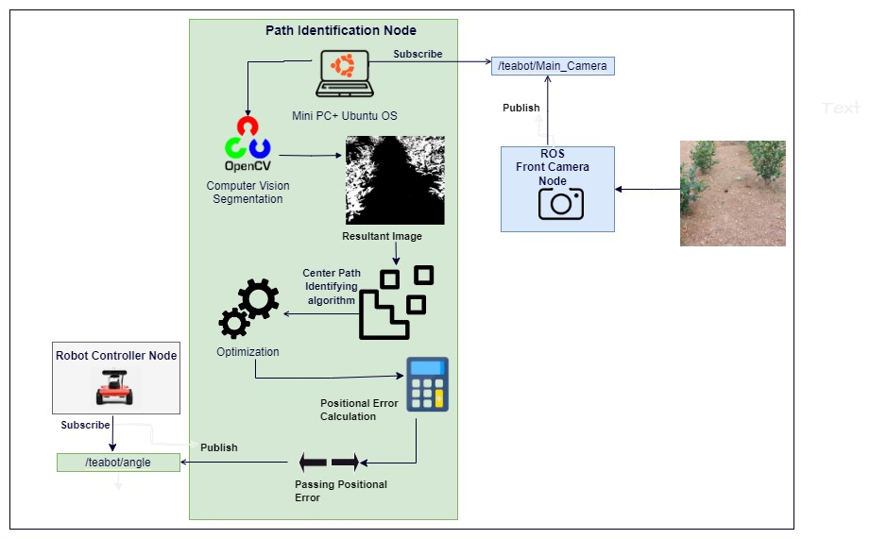
System Overview Diagram
IT20382476 | Perera P.V.Y| 2023-044

Slide 51
Possible Solution
Segmentation model to detect the center of path.
PP1 developed a U-Net model.
Finetuned the model.
Potential problems identified.
Inaccurate results for noisy images.
Lengthy output processing times.
Exhibited substantial resource consumption.
Possible solution : Classic computer vision approach
IT20382476 | Perera P.V.Y| 2023-044

Slide 52
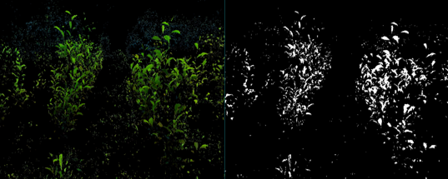
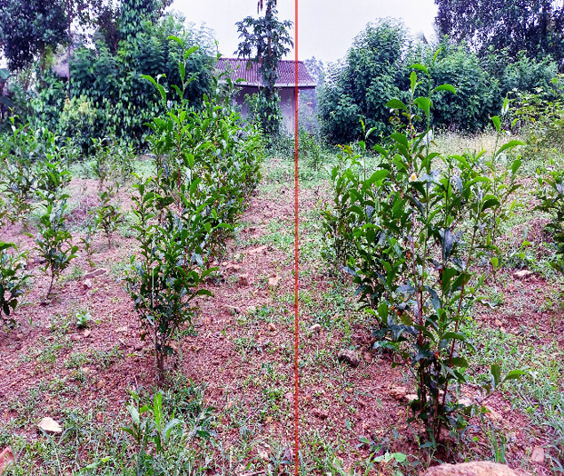
Developed Solution
Capturing a frame from the video through the webcam
Output segmented image using computer vision
Algorithm development for path identification
Pass the error to the robot controller
Calculating the position error
IT20382476 | Perera P.V.Y | 2023-044

Slide 53
ROS Node
IT20382476 | Perera P.V.Y.| 2023-044

Slide 54
METHODOLOGY
Work Breakdown Structure @PP1
Work Breakdown Structure @PP2
Technologies
Requirements
IT20382476 | Perera P.V.Y.| 2023-044

Slide 55
Work Breakdown Structure @PP1
Path Identification
Planning
Dataset Creation
Model Development
Testing & Validation
Data Transfer
Identifying requirements
Collecting the dataset
Using Unet architecture
Testing the performance in various scenarios
Transfer the position
Identifying Algorithm & function
Data preprocessing
Evaluating the performance
Finetune the model based on current performance
Test the robot in actual environment
Identifying the technologies
Labeling
Optimizing the model & offload inferencing
Allocating timeframe
Completed
To Be Completed
IT20382476 | Perera P.V.Y| 2023-044

Slide 56
Work Breakdown Structure @PP2
Path Identification
Planning
Identifying requirements
Identifying Algorithm & function
Deep Learning Based Algorithm
Using U-Net architecture
Optimizing the model & offload inferencing
Identifying the technologies
Dataset Creation
Computer Vision Algorithm
Testing & Validation
Data Transfer
Allocating timeframe
Collecting the dataset
Data preprocessing
Image transfer algorithm
Detecting the center of the path
Testing the performance in various scenarios
Finetune the model based on performance
Transfer positional error
Test the robot in actual environment
Data labeling
Performance evaluation
Testing the new algorithm
Completed
To Be Completed
IT20382476 | Perera P.V.Y| 2023-044

Slide 57




Technologies
Technologies
Python
TensorFlow
OpenCV
ROS
Qgis (Labling Tool)
Keras
VScode
Google Colab
IT20382476 | Perera P.V.Y | 2023-044

Slide 58
Requirements
Functional Requirements
Non-Functional Requirements
Adaptability
Detecting the center of the path.
Developing a Computer vision algorithm.
Performance
Efficient
Accuracy
Calculating the positional error.
IT20382476 | Perera P.V.Y | 2023-044

Slide 59
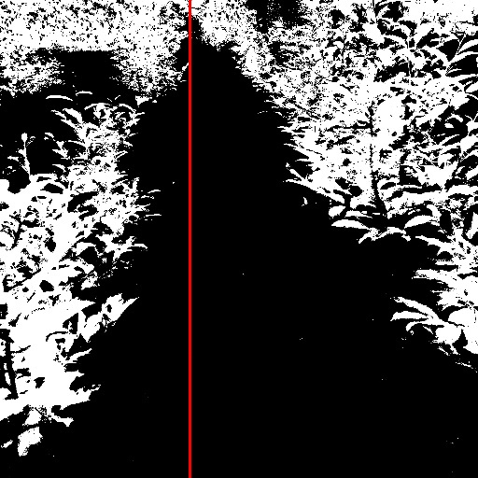
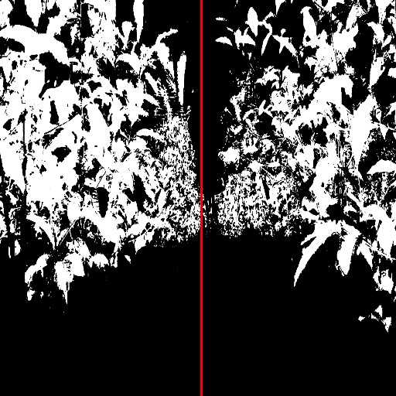
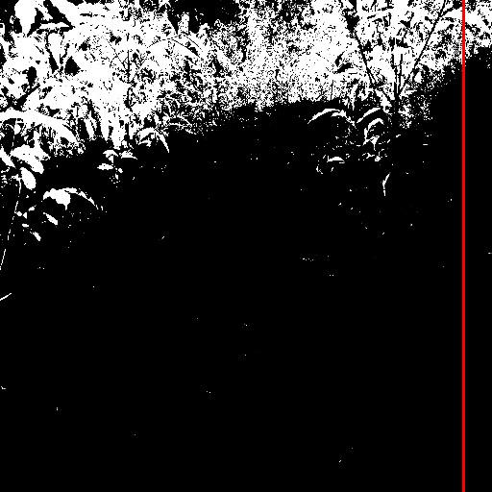
Results & Discussion
Deep Learning Approach: U-Net Segmentation model
(a)
Accurate Results
(b)
Inaccurate Results
IT20382476 | Perera P.V.Y| 2023-044

Slide 60
Results & Discussion
Drawbacks in Deep Learning Approach
Low accuracy for noisy images.
Process time of algorithm was relatively high.
Around 4-5 seconds.
U-Net model high resource consumption [5][6].
IT20382476 | Perera P.V.Y| 2023-044

Slide 61
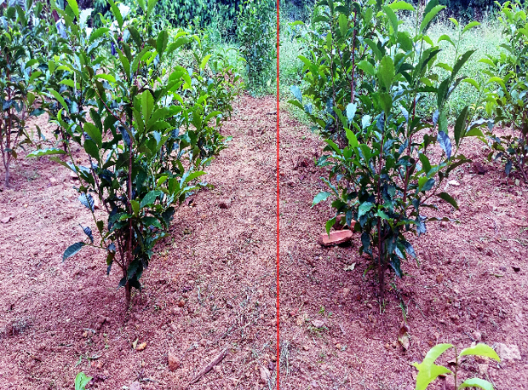
Results & Discussion
Classic Computer Vision Approach
Graphs were developed and further discussed.
IT20382476 | Perera P.V.Y| 2023-044

Slide 62
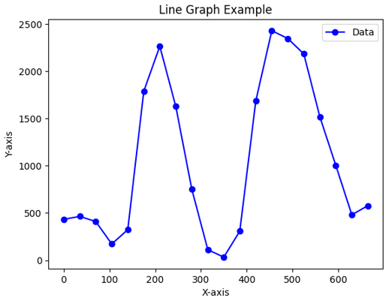
ACCURATE RESULT
X-axis = Column Index
Y-axis = White pixel count for each vertical range of columns.
IT20382476 | Perera P.V.Y| 2023-044

Slide 63
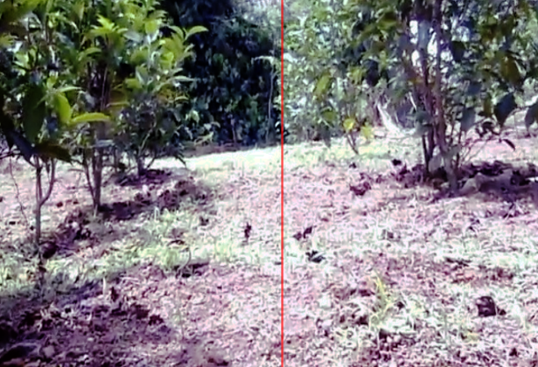
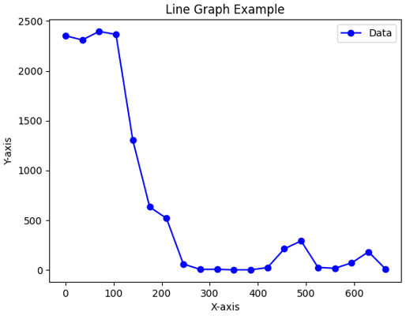
Graph Developed for INACCURATE RESULT
IT20382476 | Perera P.V.Y| 2023-044

Slide 64
Characteristics of the Graphs
Scenario | Characteristics of Graphs. | Example Graph
Accurate Results | Mean shifted double Gaussian curve IS VISIBLE
Inaccurate Results | Mean shifted double Gaussian curve NOT VISIBLE Scenarios - Paths having small tea plantations HSV color tunning will optimize performance
IT20382476 | Perera P.V.Y| 2023-044

Slide 65
Conclusion
The classic computer vision-based method is more suitable for addressing the automatic navigation problem.
Low resource consumption.
More accurate results.
Low-cost method.
Further optimizations are made to the algorithm.
HSV color tunning will perform for frames having low density of plantations.
IT20382476 | Perera P.V.Y| 2023-044

Slide 66
References
[1] D. Aghi, S. Cerrato, V. Mazzia, and M. Chiaberge, “Deep Semantic Segmentation at the Edge for Autonomous Navigation in Vineyard Rows,” IEEE Int. Conf. Intell. Robot. Syst., pp. 3421–3428, 2021, doi: 10.1109/IROS51168.2021.9635969.
[2] S. Bonadies and S. A. Gadsden, “An overview of autonomous crop row navigation strategies for unmanned ground vehicles,” Eng. Agric. Environ. Food, vol. 12, no. 1, pp. 24–31, 2019, doi: 10.1016/j.eaef.2018.09.001.
[3] S. Jaiswal and M. K. Pandey, “A Review on Image Segmentation,” Adv. Intell. Syst. Comput., vol. 1187, pp. 233–240, 2021, doi: 10.1007/978-981-15-6014-9_27.
[4] T. Zhou, W. Wang, E. Konukoglu, and L. Van Goo, “Rethinking Semantic Segmentation: A Prototype View,” Proc. IEEE Comput. Soc. Conf. Comput. Vis. Pattern Recognit., vol. 2022-June, pp. 2572–2583, 2022, doi: 10.1109/CVPR52688.2022.00261.
[5] T. T. P. Quoc, T. T. Linh, and T. N. T. Minh, “Comparing U-Net Convolutional Network with Mask R-CNN in Agricultural Area Segmentation on Satellite Images,” Proc. - 2020 7th NAFOSTED Conf. Inf. Comput. Sci. NICS 2020, pp. 124–129, 2020, doi: 10.1109/NICS51282.2020.9335856.
[6] R. Jacobs et al., “Performance and limitations of deep learning semantic segmentation of multiple defects in transmission electron micrographs,” Cell Reports Phys. Sci., vol. 3, no. 5, pp. 1–50, 2022, doi: 10.1016/j.xcrp.2022.100876.
IT20382476 | Perera P.V.Y | 2023-044

Slide 67
IT20265410 Premathilake H.T.M Information Technology
IT20265410 | Premathilake H.T.M | 2023-044

Slide 68
Background & Literature
What is stem identification?
How to identify the stem? [1],[2]
How stem identification works?
How does stem identification helps "TeaBot" to do feralization process?
Not exclusively focused on the tea plantation and preservation.
Studies have not been conducted to identify the the tea stem [3],[4],[5],[6].
Not aligned with the liquid fertilizing process.
IT20265410 | Premathilake H.T.M | 2023-044

Slide 69
Research Problem
How to give the coordinates of the detected tea stem through the developed algorithm in order to fulfill the liquid fertilizing process?
IT20265410 | Premathilake H.T.M | 2023-044

Slide 70
Specific and Sub Objectives
Main Objective
Develop an algorithm to detect the tea stem and pass the value to the liquid spraying controller.
Sub-Objectives
Implement an algorithm to accurately detect the tea stem.
Develop a Classic Computer Vision algorithm to segment the input frame.
Algorithm creation to detect the tea stem.
Test and validate the performance in various scenarios and fine-tune the algorithm.
IT20265410 | Premathilake H.T.M | 2023-044

Slide 71
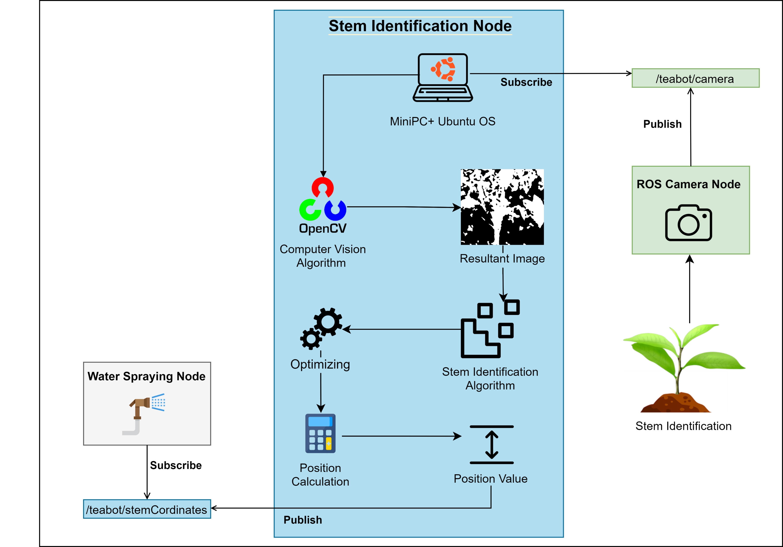
System Overview Diagram
IT20265410 | Premathilake H.T.M | 2023-044

Slide 72
Possible Solutions
Image processing model to identify the tea stem
PP1 developed a ResNet50 model.
Resnet50 model was light weighted as MobileNetV2.
Potential problems identified.
Lengthy output processing times (4-5 seconds).
Possible solution : Classic computer vision approach
IT20265410 | Premathilake H.T.M | 2023-044

Slide 73
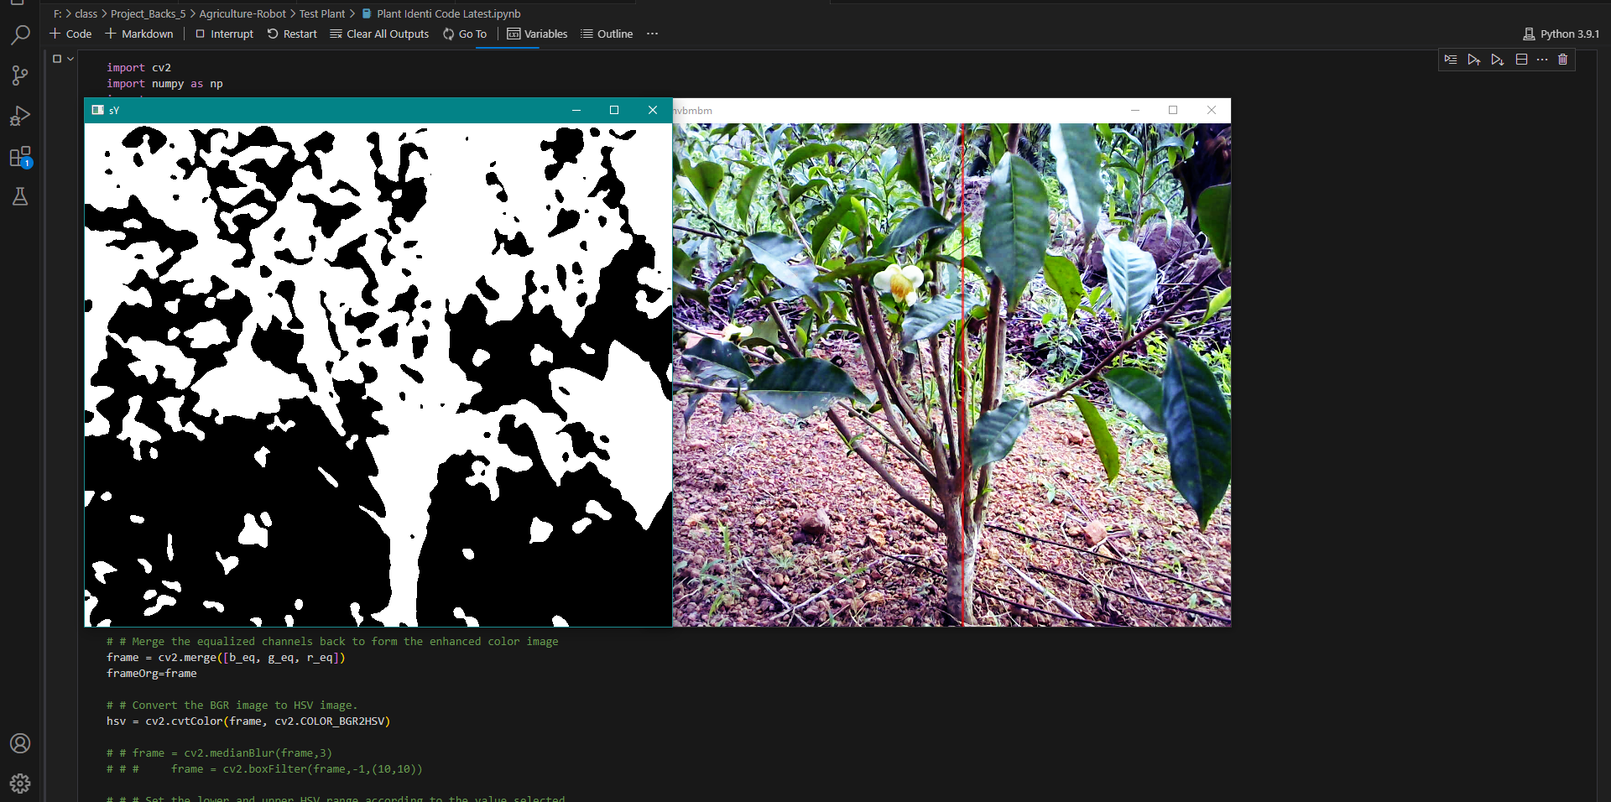
Developed Solution
Capturing a frame from the video through the webcam
Output segmented image using computer vision
Algorithm development for stem identification
Pass the value to the water controlling node
Calculating the position of the stem
IT20265410 | Premathilake H.T.M | 2023-044

Slide 74
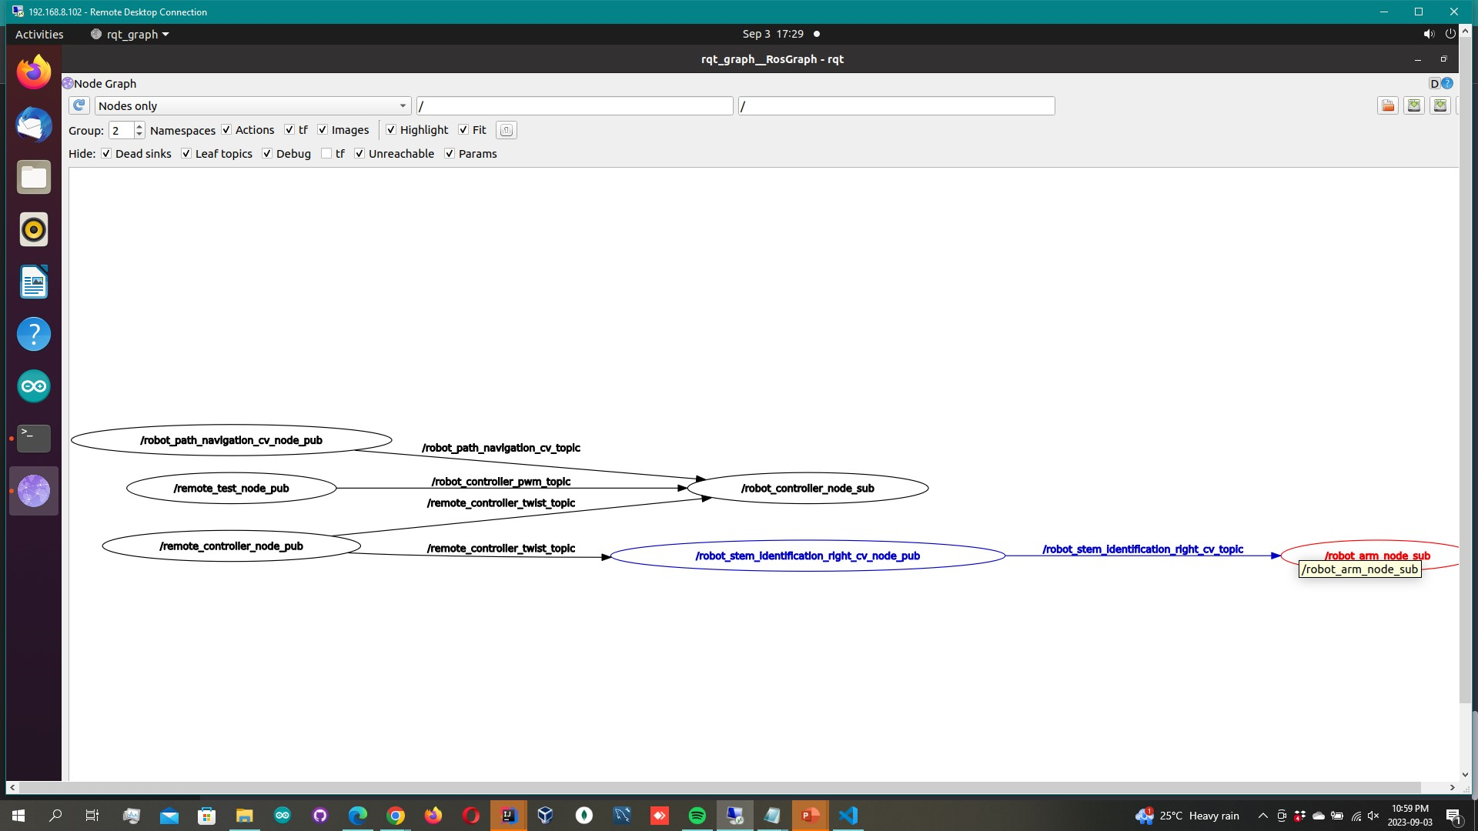
ROS Node
IT20382476 | Perera P.V.Y.| 2023-044

Slide 75
METHODOLOGY
Work Breakdown Structure @PP1
Work Breakdown Structure @PP2
Technologies
Requirements
IT20265410 | Premathilake H.T.M | 2023-044

Slide 76
Work Breakdown Structure @PP1
Tea Stem Identification
Planning
Dataset Creation
Model Development
Testing & Validation
Data Transfer
Identifying requirements
Collecting the dataset
Using ResNet50 architecture
Testing and verifying accuracy
Integrating the ML model
Identifying Algorithm & function
Data preprocessing
Developing a lightweight model
Evaluating the performance
Transferring the coordinators
Identifying the technologies
Labeling
Optimizing the model
Validating the output result
Allocating timeframe
Completed
To Be Completed
IT20265410 | Premathilake H.T.M | 2023-044

Slide 77
Work Breakdown Structure @PP2
Tea Stem Identification
Planning
Identifying requirements
Identifying Algorithm & function
Image Processing Algorithm
Using ResNet50 architecture
Identifying the technologies
Dataset Creation
Computer Vision Algorithm
Testing & Validation
Data Transfer
Allocating timeframe
Collecting the dataset
Data preprocessing
Develop image transfer algorithm
Detecting the tea stem
Testing the performance in various scenarios
Testing
Transfer position value
Test the robot in actual environment
Data labeling
Developed a lightweight model
Finetune the algorithm based on performance
Completed
To Be Completed
IT20265410 | Premathilake H.T.M | 2023-044

Slide 78
Technologies
Technologies
Python
TensorFlow
OpenCV
ROS
Keras
Google Colab
IT20265410 | Premathilake H.T.M | 2023-044

Slide 79
Requirements
Functional Requirements
Non-Functional Requirements
Adaptability
Capability to get the correct value
Precisely identify the tea stem
Capability to pass the accurate value to the liquid spraying controller
Performance
Efficient
Accuracy
IT20265410 | Premathilake H.T.M | TMP-23-044

Slide 80
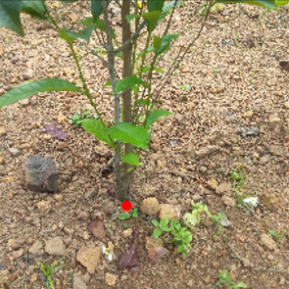
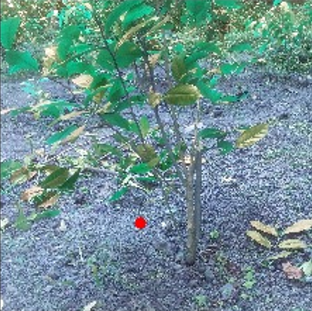
Results & Discussion
Image Processing Approach
(a)
Accurate Results
(b)
Inaccurate Results
IT20265410 | Premathilake H.T.M | 2023-044

Slide 81
Results & Discussion
Drawbacks in Image Processing Approach
MobileNetV2 resulted a lengthy output time.
Around 4-5 seconds
Training MobileNetV2 from scratch on custom datasets is a challenge.
IT20265410 | Premathilake H.T.M | 2023-044

Slide 82
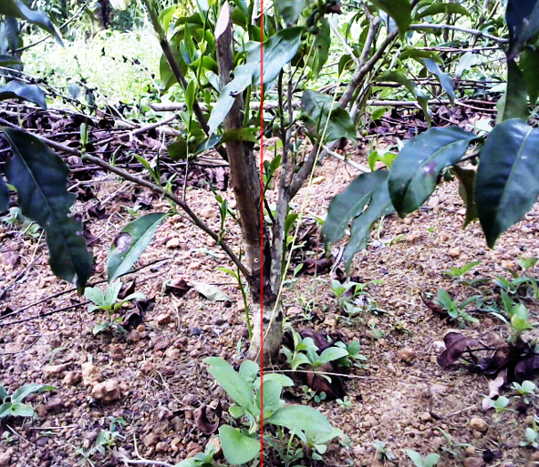
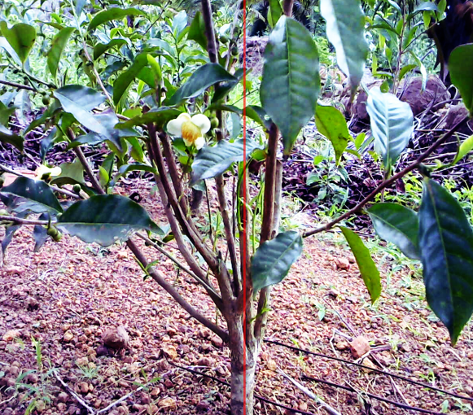
Results & Discussion
Classic Computer Vision Approach
(a) Accurate Results
IT20265410 | Premathilake H.T.M | 2023-044

Slide 83
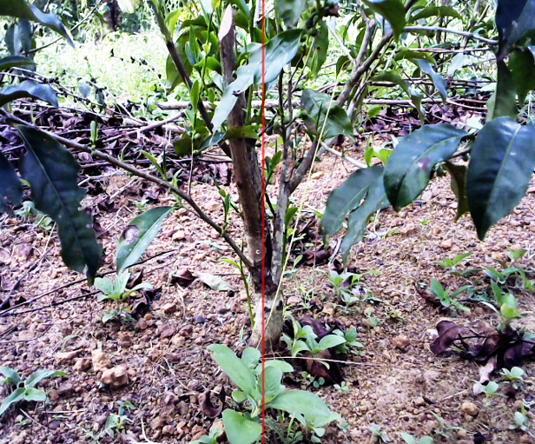
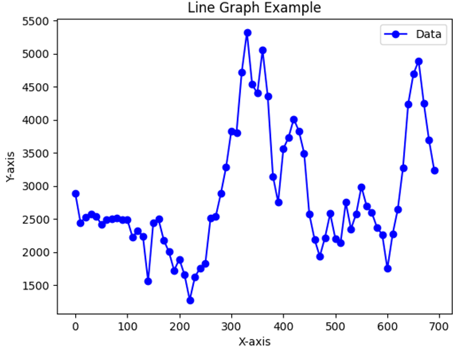
ACCURATE RESULT
X-axis = Column index
Y-axis = Pixel value summation for each vertical column
IT20265410 | Premathilake H.T.M | 2023-044

Slide 84
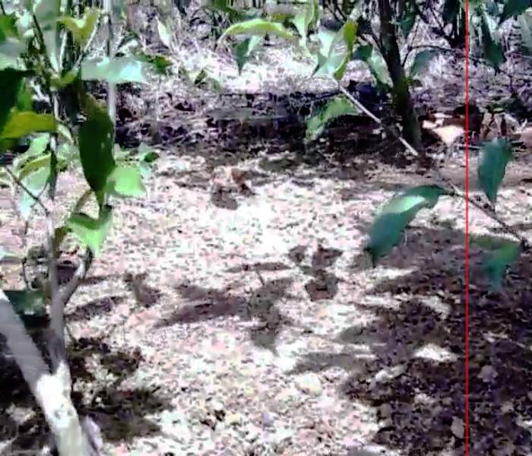
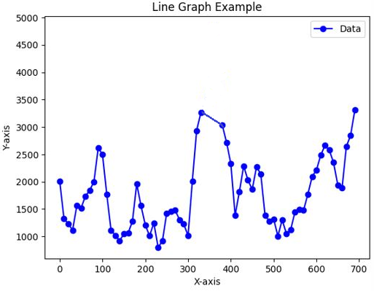
INACCURATE RESULT
IT20265410 | Premathilake H.T.M | 2023-044

Slide 85
Conclusion
The classic computer vision-based method is more suitable for detecting the tea stem for utilizing the liquid fertilization process.
Low resource consumption.
Output is published withing 1 second.
Low-cost method.
Further optimizations are made to the algorithm
Color tunning for small plantations.
Optimizing the edge detection algorithm.
IT20265410 | Premathilake H.T.M | 2023-044

Slide 86
References
[1] “Localised feature comparison between VGG-16 and ResNet-50. Although... | Download Scientific Diagram.” https://www.researchgate.net/figure/Localised-feature-comparison-between-VGG-16-and-ResNet-50-Although-both-models-extracted_fig6_328440990 (accessed May 11, 2023).
[2] “Accuracy and loss values for the VGG16 and ResNet50 models on the... | Download Scientific Diagram.” https://www.researchgate.net/figure/Accuracy-and-loss-values-for-the-VGG16-and-ResNet50-models-on-the-GAN-augmented-dataset_fig1_352142241 (accessed May 11, 2023).
[3] L. A. Wells and W. Chung, “Real-Time Computer Vision for Tree Stem Detection and Tracking,” For. 2023, Vol. 14, Page 267, vol. 14, no. 2, p. 267, Jan. 2023, doi: 10.3390/F14020267.​
[4] C. W. Bac, J. Hemming, and E. J. Van Henten, “Stem localization of sweet-pepper plants using the support wire as a visual cue,” Comput. Electron. Agric., vol. 105, pp. 111–120, Jul. 2014, doi: 10.1016/J.COMPAG.2014.04.011.​
[5] R. P. Haff, D. C. Slaughter, and E. S. Jackson, “X-Ray Based Stem Detection in an Automatic Tomato Weeding System,” Appl. Eng. Agric., vol. 27, no. 5, pp. 803–810, 2011, doi: 10.13031/2013.39559.​
[6] W. Wang, C. Li, K. Wang, L. Tang, P. F. Ndiluau, and Y. Cao, “Sugarcane stem node detection and localization for cutting using deep learning,” Front. Plant Sci., vol. 13, p. 5181, Dec. 2022, doi: 10.3389/FPLS.2022.1089961/BIBTEX.
IT20265410 | Premathilake H.T.M | 2023-044

Slide 87
IT20011970 Bamunusinghe G.P Software Engineering
IT20011970 | Bamunusinghe G.P | 2023-044

Slide 88
Background & Literature
The movement of the robot arm and the liquid nozzles must be precisely controlled to ensure the accuracy and efficiency of the application.
The velocity of the robot affects the movement of the robotic arm’s movement of the liquid nozzles, and this must be taken into account in the control system.
Stabilizer is a widely used method for fine-tuning the movement of robotic arms[5], including the movement of liquid nozzles in liquid sprayer systems.
Regulating water pressure is also important to ensure consistent application.
IT20011970 | Bamunusinghe G.P | 2023-044

Slide 89
Research Problem
How to water the plants precisely according to the coordinates with the relative velocity of the robot ?
IT20011970 | Bamunusinghe G.P | 2023-044

Slide 90
Specific and Sub Objectives
Main Objective
To Develop the liquid nozzles controller of the TeaBot to liquid fertilize the tea plants more efficiently.
Sub-Objectives
Develop the motor controlling for the nozzles with Stabilizer.
Move the liquid nozzles to the exact spot with the given coordinates by the controller.
Develop the nozzle movements with the given coordinates by computer vision
To move the nozzles with the relative velocity of the robot.
To regulate water pressure and, if water blocks occur, have the system turn itself off
IT20011970 | Bamunusinghe G.P | TMP-23-044

Slide 91
Hardware - Robot Arm
Arduino Nano – 1
Servo motors (NG 995) – 4
Water pump (R385) – 2
Stabilizer (MPU6050)– 2
LM785 converter – 2
Sprinkler – 2
Motor driver (L298) –1
Cost – Rs. 10,150
IT19973470 | Gunawardana I.I.E | 2023-044

Slide 92
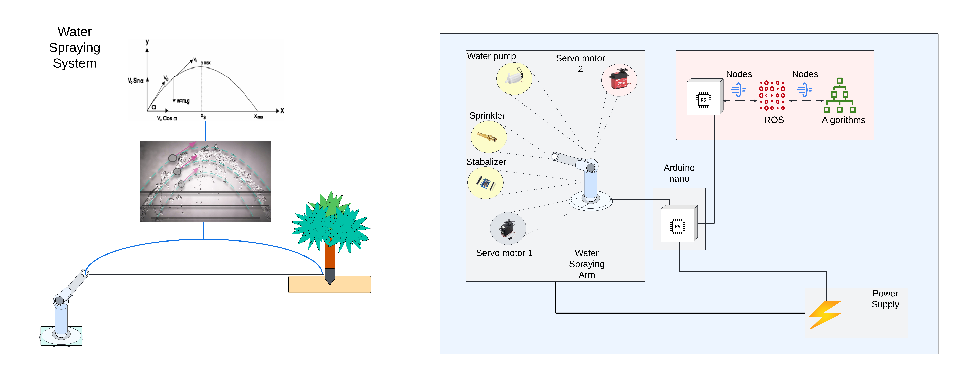
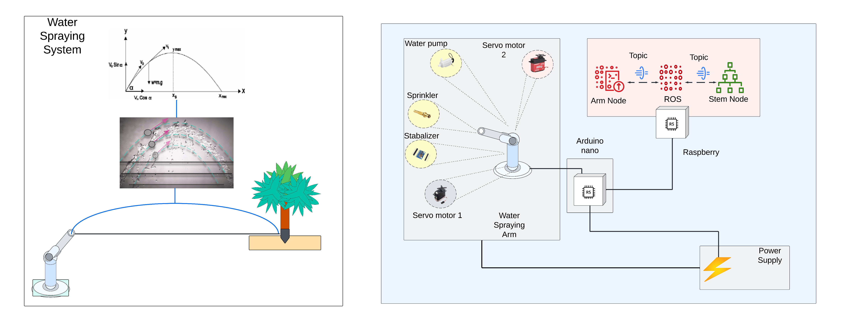
System Overview Diagram
IT20011970 | Bamunusinghe G.P | 2023-044

Slide 93
Possible Solution
Use looping motor control systems to water the plants.
Use same movements to rotate motors.
Speed of the pump is constant in each situation.
Potential problems identified.
Water wastage.
Low accuracy at water spraying.
Possible solution : Use computer vision approach to water plants
IT20011970 | Bamunusinghe G.P | 2023-044

Slide 94
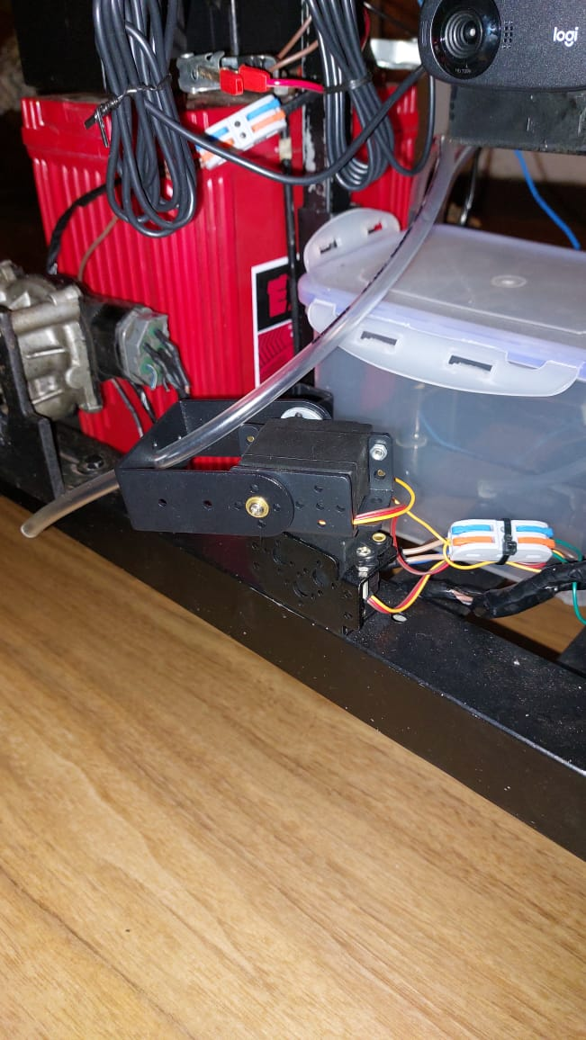
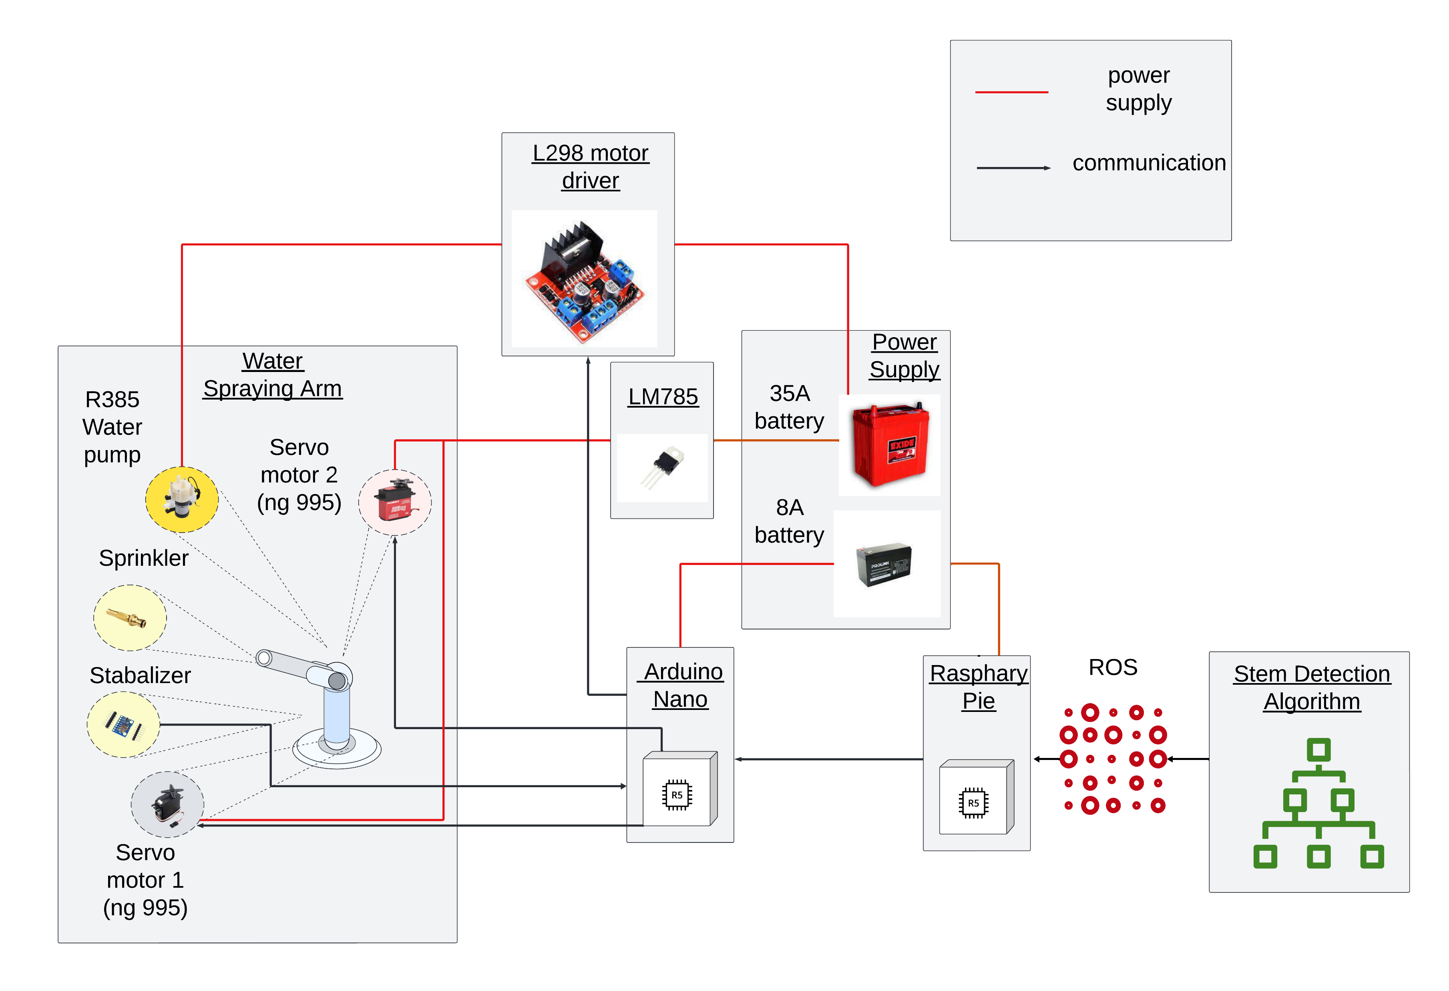
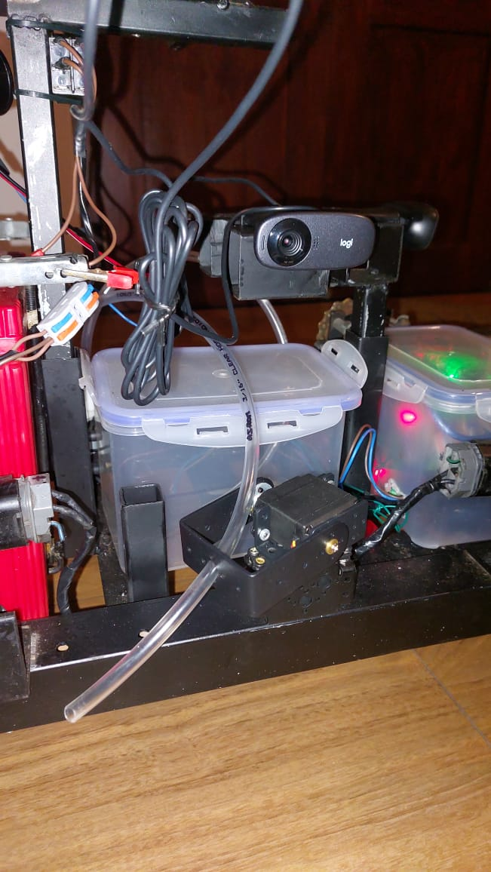
Developed Solution
IT20011970 | Bamunusinghe G.P | 2023-044

Slide 95
ROS Node
IT20382476 | Perera P.V.Y.| 2023-044

Slide 96
METHODOLOGY
Work Breakdown Structure @PP1
Work Breakdown Structure @PP2
Technologies
Requirements
IT20011970 | Bamunusinghe G.P | 2023-044

Slide 97
Work Breakdown Structure @PP1
Liquid Sprayer
Arm & Hardware
Algorithm & Software
Integration
Mechanical design
Ideation
Laser tracker
Arm design
Coding
Hardware development
Firmware
Testing
Assembling
Assembling
Tuning
Completed
To Be Completed
IT20011970 | Bamunusinghe G.P | TMP-23-044

Slide 98
Work Breakdown Structure @PP2
Liquid Sprayer
Arm & Hardware
Algorithm & Software
Integration
Mechanical design
Ideation
Laser tracker
Arm design
Coding
Hardware integration
Firmware
Testing
Assembling
Assembling
Tuning
Completed
To Be Completed
IT20011970 | Bamunusinghe G.P | 2023-044

Slide 99


Technologies
Technologies
Python
ROS Noetic
Algorithms
Pixel count convert to servo angles
Servo Motor Control
Raspberry Pi
Ubuntu 20.0.4
Arduino
Stabilizer
OpenCV
IT20011970 | Bamunusinghe G.P | 2023-044

Slide 100
Requirements
Functional Requirements
Non-Functional Requirements
Accuracy
Performance
Speed
Water spraying to the stem
Rotation of the water arm
Water spraying angle control
Water pressure control
Reusability
IT20011970 | Bamunusinghe G.P | 2023-044

Slide 101
Results & Discussion
For various scenarios Arm accuracy will depend on stem detection results.
Low accuracy in arm algorithm is identified for small tea plantations.
Pixel count difference VS time gap
Low accuracy for pixel count difference between previous position and current position per second is more than 200.
IT20011970 | Bamunusinghe G.P | 2023-044
IT20011970 | Bamunusinghe G.P | 2023-044

Slide 102
Accuracy of the spraying arm according to the time gap VS Pixel count
Time Gap (s) | Pixel count difference | Accuracy
1 | 100 | Accurate
1 | 200 | Accurate
1 | 300 | Not-Accurate
1 | 400 | Not-Accurate
1 | 500 | Not-Accurate
2 | 100 | Accurate
2 | 200 | Accurate
2 | 300 | Not-Accurate
2 | 400 | Not-Accurate
2 | 500 | Not-Accurate
3 | 100 | Not-Accurate
3 | 200 | Not-Accurate
3 | 300 | Not-Accurate
3 | 400 | Not-Accurate
3 | 500 | Not-Accurate
4 | 100 | Not-Accurate
4 | 200 | Not-Accurate
4 | 300 | Not-Accurate
4 | 400 | Not-Accurate
4 | 500 | Not-Accurate
IT20011970 | Bamunusinghe G.P | 2023-044

Slide 103
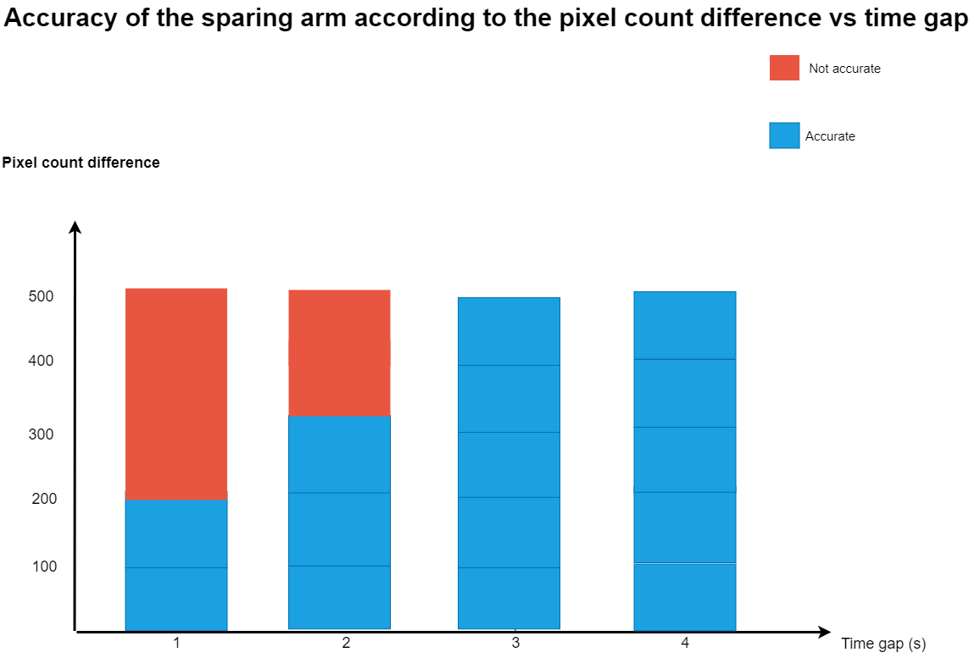
Graph Developed of RESULT
IT20011970 | Bamunusinghe G.P | 2023-044

Slide 104
Conclusion
The classic computer vision-based spraying system is more suitable for watering plants.
Low water wastage.
Accurate water spraying.
Further optimizations are made to the arm.
Laser tracker to control y axis of the robot.
Tune variables to cancel noise.
IT20011970 | Bamunusinghe G.P | 2023-044

Slide 105
References
[1]A. Shilpa, V. Muneeswaran, and D. Devi Kala Rathinam, “A Precise and Autonomous Irrigation System for Agriculture: IoT Based Self Propelled Center Pivot Irrigation System,” 2019 5th Int. Conf. Adv. Comput. Commun. Syst. ICACCS 2019, pp. 533–538, Mar. 2019, doi: 10.1109/ICACCS.2019.8728550.
[2] a G. Smajstrla et al., “Efficiencies of Florida Agricultural Irrigation Systems,” BUL247, Univ. Florida, no. July 2002, p. 14, 2002.
[3] A. Heideker, D. Ottolini, I. Zyrianoff, A. T. Neto, T. Salmon Cinotti, and C. Kamienski, “IoTbased Measurement for Smart Agriculture,” 2020 IEEE Int. Work. Metrol. Agric. For. MetroAgriFor 2020 - Proc., pp. 68–72, 2020, doi: 10.1109/MetroAgriFor50201.2020.9277546.
[4] D. Cooley, R. M. Maxwell, and S. M. Smith, “Center Pivot Irrigation Systems and Where to Find Them: A Deep Learning Approach to Provide Inputs to Hydrologic and Economic Models,” Front. Water, vol. 3, Dec. 2021, doi: 10.3389/frwa.2021.786016.
[5] C. Cruz Ulloa, A. Krus, A. Barrientos, J. del Cerro, and C. Valero, “Robotic Fertilization in Strip Cropping using a CNN Vegetables Detection-Characterization Method,” Comput. Electron. Agric., vol. 193, no. January, p. 106684, 2022, doi: 10.1016/j.compag.2022.106684.
[6]“Greenhouse Irrigation - What’s the best watering system? | Greenhouse Emporium.” https://greenhouseemporium.com/blogs/greenhouse-gardening/greenhouse-irrigationsystems/ (accessed Mar. 20, 2023).
IT20011970 | Bamunusinghe G.P | 2023-044

Slide 106
Demonstration

Slide 107
IT19973470 Gunawardana I.I.E Software Engineering
IT19973470 | Gunawardana I.I.E | 2023-044

Slide 108
IT20382476 Perera P.V.Y Data Science
IT20382476 | Perera P.V.Y | 2023-044

Slide 109
IT20265410 Premathilake H.T.M Information Technology
IT20265410 | Premathilake H.T.M | 2023-044

Slide 110
IT20011970 Bamunusinghe G.P Software Engineering
IT20011970 | Bamunusinghe G.P | 2023-044

Slide 111
Q & A

Slide 112
THANK YOU!

